Slide 1
CS101 Algorithms and Data Structures
Array and Linked List
Textbook Ch 10.2
Notes:
Adapted from the slides by Douglas Wilhelm Harder of U Waterloo (https://ece.uwaterloo.ca/~dwharder/aads/Lecture_materials/)
May also contain material from the slides at https://courses.cs.washington.edu/courses/cse326/03wi/326lecturesb.shtml (by Dan Suciu of U Washington)

Slide 2
Outline
List ADT
Array
Linked list
Doubly linked list
Node-based storage with arrays

Slide 3
Ex1 compute the summation for a polynomial at a fixed value x.
$$f\left(x\right)=a_{0}+a_{1}x+a_{2}x^{2}+⋯+a_{n−1}x^{n−1}+a_{n}x^{n}$$
double fpoly1 ( int n, double a[ ], double x )
{ int i;
double p = a[0];
for (i = 1; i <=n; i++)
p += (a[i] * pow( x, i) );
return p;
}
$$f\left(x\right)=a_{0}+x{(a}_{1}+x(a_{2}+⋯x(a_{n−1}+x\left(a_{n}\right))⋯))$$
double fpoly2 ( int n, double a[ ], double x )
{ int i;
double p = a[n];
for (i = n; i > 0; i-- )
p = a[i-1] + x* p;
return p;
}

Slide 4
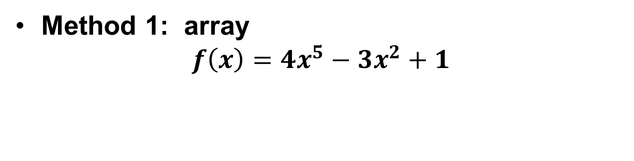
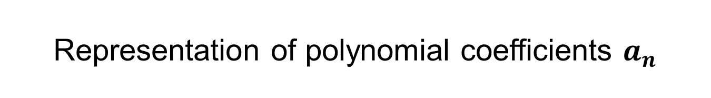



Representation of polynomial coefficients $a_{n}$
$$f\left(x\right)=a_{0}+a_{1}x+a_{2}x^{2}+⋯+a_{n−1}x^{n−1}+a_{n}x^{n}$$
double fpoly1 ( int n, double a[ ], double x )
{ int i;
double p = a[0];
for (i = 1; i <=n; i++)
p += (a[i] * pow( x, i) );
return p;
}
Method 1: array
$$f\left(x\right)=4x^{5}−3x^{2}+1$$
$$a[i]$$
1
0
-3
0
0
4
$$⋯$$
Array indices
0
1
2
3
4
5
$$⋯$$
Problem?

Slide 5







Discussion 1
( 4 0 0 0 0 0 0 0 0 0 0 0 0 0 0 0 0 0 0 0 0 0 0 0 0 0 0 0 0 0 0 0 0 0 0 0 0 0 0 0 0 0 0 0 0 0 0 0 0 0 0 0 0 0 0 0 0 0 0 0 0 0 0 0 0 0 0 0 0 0 0 0 0 0 0 0 0 0 0 0 0 0 0 0 0 0 0 0 0 0 0 0 0 0 0 0 0 0 0 0 0 0 0 0 0 0 0 0 0 0 0 0 0 0 0 0 0 0 0 0 0 0 0 0 0 0 0 0 0 0 0 0 0 0 0 0 0 0 0 0 0 0 0 0 0 0 0 0 0 0 0 0 0 0 0 0 0 0 0 0 0 0 0 0 0 0 0 0 0 0 0 0 0 0 0 0 0 0 0 0 0 0 0 0 0 0 0 0 0 0 0 0 0 0 0 0 0 0 0 0 0 0 0 0 0 0 0 0 0 0 0 0 0 0 0 0 0 0 0 0 0 0 0 0 0 0 0 0 0 0 0 0 0 0 0 0 0 0 0 0 0 0 0 0 0 0 0 0 0 0 0 0 0 0 0 0 0 0 0 0 0 0 0 0 0 0 0 0 0 0 0 0 0 0 0 0 0 0 0 0 0 0 0 0 0 0 0 0 0 0 0 0 0 0 0 0 0 0 0 0 0 0 0 0 0 0 0 0 0 0 0 0 0 0 0 0 0 0 0 0 0 0 0 0 0 0 0 0 0 0 0 0 0 0 0 0 0 0 0 0 0 0 0 0 0 0 0 0 0 0 0 0 0 0 0 0 0 0 0 0 0 0 0 0 0 0 0 0 0 0 0 0 0 0 0 0 0 0 0 0 0 0 0 0 0 0 0 0 0 0 0 0 0 0 0 0 0 0 0 0 0 0 0 0 0 0 0 0 0 0 0 0 0 0 0 0 0 0 0 0 0 0 0 0 0 0 0 0 0 0 0 0 0 0 0 0 0 0 0 0 0 0 0 0 0 0 0 0 0 0 0 0 0 0 0 0 0 0 0 0 0 0 0 0 0 0 0 0 0 0 0 0 0 0 0 0 0 0 0 0 0 0 0 0 0 0 0 0 0 0 0 0 0 0 0 0 0 0 0 0 0 0 0 0 0 0 0 0 0 0 0 0 0 0 0 0 0 0 0 0 0 0 0 0 0 0 0 0 0 0 0 0 0 0 0 0 0 0 0 0 0 0 0 0 0 0 0 0 0 0 0 0 0 0 0 0 0 0 0 0 0 0 0 0 0 0 0 0 0 0 0 0 0 0 0 0 0 0 0 0 0 0 0 0 0 0 0 0 0 0 0 0 0 0 0 0 0 0 0 0 0 0 0 0 0 0 0 0 0 0 0 0 0 0 0 0 0 0 0 0 0 0 0 0 0 0 0 0 0 0 0 0 0 0 0 0 0 0 0 0 0 0 0 0 0 0 0 0 0 0 0 0 0 0 0 0 0 0 0 0 0 0 0 0 0 0 0 0 0 0 0 0 0 0 0 0 0 0 0 0 0 0 0 0 0 0 0 0 0 0 0 0 0 0 0 0 0 0 0 0 0 0 0 0 0 0 0 0 0 0 0 0 0 0 0 0 0 0 0 0 0 0 0 0 0 0 0 0 0 0 0 0 0 0 0 0 0 0 0 0 0 0 0 0 0 0 0 0 0 0 0 0 0 0 0 0 0 0 0 0 0 0 0 0 0 0 0 0 0 0 0 0 0 0 0 0 0 0 0 0 0 0 0 0 0 0 0 0 0 0 0 0 0 0 0 0 0 0 0 0 0 0 0 0 0 0 0 0 0 0 0 0 0 0 0 0 0 0 0 0 0 0 0 0 0 0 0 0 0 0 0 0 0 0 0 0 0 0 0 0 0 0 0 0 0 0 0 0 0 0 0 0 0 0 0 0 0 0 0 0 0 0 0 0 0 0 0 0 0 0 0 0 0 0 0 0 0 0 0 0 0 0 0 0 0 0 0 0 0 0 0 0 0 0 0 0 0 0 0 0 0 0 0 0 0 0 0 0 0 0 0 0 0 0 0 0 0 0 0 0 0 0 0 0 0 0 0 0 0 0 0 0 0 0 0 0 0 0 0 0 0 0 0 0 0 0 0 0 0 0 0 0 0 0 0 0 0 0 0 0 0 0 0 0 0 0 0 0 0 0 0 0 0 0 0 0 0 0 0 0 0 0 0 0 0 0 0 0 0 0 0 0 0 0 0 0 0 0 0 0 0 0 0 0 0 0 0 0 0 0 0 0 0 0 0 0 0 0 0 0 0 0 0 0 0 0 0 0 0 0 0 0 0 0 0 0 0 0 0 0 0 0 0 0 0 0 0 0 0 0 0 0 0 0 0 0 0 0 0 0 0 0 0 0 0 0 0 0 0 0 0 0 0 0 0 0 0 0 0 0 0 0 0 0 0 0 0 0 0 0 0 0 0 0 0 0 0 0 0 0 0 0 0 0 0 0 0 0 0 0 0 0 0 0 0 0 0 0 0 0 0 0 0 0 0 0 0 0 0 0 0 0 0 0 0 0 0 0 0 0 0 0 0 0 0 0 0 0 0 0 0 0 0 0 0 0 0 0 0 0 0 0 0 0 0 0 0 0 0 0 0 0 0 0 0 0 0 0 0 0 010 0 0 0 0 0 0 0 0 0 0 0 0 0 0 0 0 0 0 0 0 0 0 0 0 0 0 0 0 0 0 0 0 0 0 0 0 0 0 0 0 0 0 0 0 0 0 0 0 0 0 0 0 0 0 0 0 0 0 0 0 0 0 0 0 0 0 0 0 0 0 0 0 0 0 0 0 0 0 0 0 0 0 0 0 0 0 0 0 0 0 0 0 0 0 0 0 0 0 0 0 0 0 0 0 0 0 0 0 0 0 0 0 0 0 0 0 0 0 0 0 0 0 0 0 0 0 0 0 0 0 0 0 0 0 0 0 0 0 0 0 0 0 0 0 0 0 0 0 0 0 0 0 0 0 0 0 0 0 0 0 0 0 0 0 0 0 0 0 0 0 0 0 0 0 0 0 0 0 0 0 0 0 0 0 0 0 0 0 0 0 0 0 0 0 0 0 0 0 0 0 0 0 0 0 0 0 0 0 0 0 0 0 0 0 0 0 0 0 0 0 0 0 0 0 0 0 0 0 0 0 0 0 0 0 0 0 0 0 0 0 0 0 0 0 0 0 0 0 0 0 0 0 0 0 0 0 0 0 0 0 0 0 0 0 0 0 0 0 0 0 0 0 0 0 0 0 0 0 0 0 0 0 0 0 0 0 0 0 0 0 0 0 0 0 0 0 0 0 0 0 0 0 0 0 0 0 0 0 0 0 0 0 0 0 0 0 0 0 0 0 0 0 0 0 0 0 0 0 0 0 0 0 0 0 0 0 0 0 0 0 0 0 0 0 0 0 0 0 0 0 0 0 0 0 0 0 0 0 0 0 0 0 0 0 0 0 0 0 0 0 0 0 0 0 0 0 0 0 0 0 0 0 0 0 0 0 0 0 0 0 0 0 0 0 0 0 0 0 0 0 0 0 0 0 0 0 0 0 0 0 0 0 0 0 0 0 0 0 0 0 0 0 0 0 0 0 0 0 0 0 0 0 0 0 0 0 0 0 0 0 0 0 0 0 0 0 0 0 0 0 0 0 0 0 0 0 0 0 0 0 0 0 0 0 0 0 0 0 0 0 0 0 0 0 0 0 0 0 0 0 0 0 0 0 0 0 0 0 0 0 0 0 0 0 0 0 0 0 0 0 0 0 0 0 0 0 0 0 0 0 0 0 0 0 0 0 0 0 0 0 0 0 0 0 0 0 0 0 0 0 0 0 0 0 0 0 0 0 0 0 0 0 0 0 0 0 0 0 0 0 0 0 0 0 0 0 0 0 0 0 0 0 0 0 0 0 0 0 0 0 0 0 0 0 0 0 0 0 0 0 0 0 0 0 0 0 0 0 0 0 0 0 0 0 0 0 0 0 0 0 0 0 0 0 0 0 0 0 0 0 0 0 0 0 0 0 0 0 0 0 0 0 0 0 0 0 0 0 0 0 0 0 0 0 0 0 0 0 0 0 0 0 0 0 0 0 0 0 0 0 0 0 0 0 0 0 0 0 0 0 0 0 0 0 0 0 0 0 0 0 0 0 0 0 0 0 0 0 0 0 0 0 0 0 0 0 0 0 0 0 0 0 0 0 0 0 0 0 0 0 0 0 0 0 0 0 0 0 0 0 0 0 0 0 0 0 0 0 0 0 0 0 0 0 0 0 0 0 0 0 0 0 0 0 0 0 0 0 0 0 0 0 0 0 0 0 0 0 0 0 0 0 0 0 0 0 0 0 0 0 0 0 0 0 0 0 0 0 0 0 0 0 0 0 0 0 0 0 0 0 0 0 0 0 0 3 )
How to present coefficients for$f\left(x\right)=4+3x^{2001}$?
$$a[i]$$
4
0
0
0
$$⋯$$
$$⋯$$
3
Array indices
0
1
2
3
$$⋯$$
$$⋯$$
$200$1

Slide 6
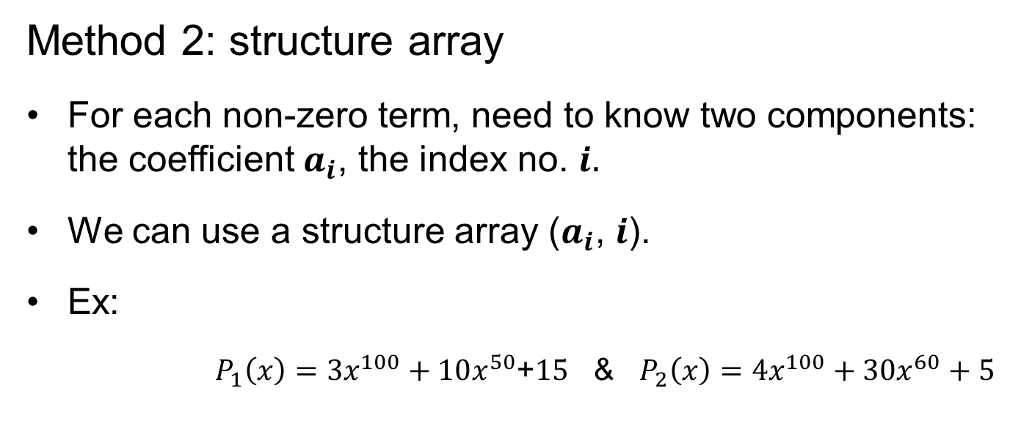




Method 2: structure array
For each non-zero term, need to know two components: the coefficient $a_{i}$, the index no. $i.$
We can use a structure array ($a_{i}$, $i$).
Ex:
$P_{1}\left(x\right)=3x^{100}+10x^{50}$+$15$ & $P_{2}\left(x\right)=4x^{100}+30x^{60}+5$
$$a[i]$$
3
10
15
4
30
5
Expon index $i$
100
50
0
100
60
0
Array indices
0
1
2
$$⋯$$
0
1
2
$$⋯$$
Store the coefficients in descent order of exponential index.
Notes:
比方说第一个数组的第零个分量，这就是一个结构，指出了多项式中国第一个系数不为零的项的系数和阶数。
按指数大小有序排列是为了计算方便（加法）

Slide 7




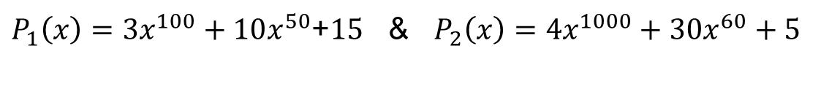
Addition of Two Polynomials?
$P_{1}\left(x\right)=3x^{100}+10x^{50}$+$15$ & $P_{2}\left(x\right)=4x^{1000}+30x^{60}+5$
$$a[i]$$
3
10
15
4
30
5
Expon index $i$
100
50
0
100
60
0
Array indices
0
1
2
$$⋯$$
0
1
2
$$⋯$$

Slide 8
Addition of Two Polynomials?
$P_{1}\left(x\right)=3x^{100}+10x^{50}$+$15$ & $P_{2}\left(x\right)=4x^{1000}+30x^{60}+5$
$$a[i]$$
3
10
15
4
30
5
Expon index $i$
100
50
0
100
60
0
Array indices
0
1
2
$$⋯$$
0
1
2
$$⋯$$

Slide 9




Addition of Two Polynomials?
$P_{1}\left(x\right)=3x^{100}+10x^{50}$+$15$ & $P_{2}\left(x\right)=4x^{1000}+30x^{60}+5$
$$a[i]$$
3
10
15
4
30
5
Expon index $i$
100
50
0
100
60
0
Array indices
0
1
2
$$⋯$$
0
1
2
$$⋯$$
$$a[i]$$
Expon index $i$
Array indices
0
1
2
$$3$$
4
5
6
$$⋯$$

Slide 10
Addition of Two Polynomials?
$P_{1}\left(x\right)=3x^{100}+10x^{50}$+$15$ & $P_{2}\left(x\right)=4x^{1000}+30x^{60}+5$
$$a[i]$$
3
10
15
4
30
5
Expon index $i$
100
50
0
100
60
0
Array indices
0
1
2
$$⋯$$
0
1
2
$$⋯$$
$$a[i]$$
7
Expon index $i$
100
Array indices
0
1
2
$$3$$
4
5
6
$$⋯$$

Slide 11
Addition of Two Polynomials?
$P_{1}\left(x\right)=3x^{100}+10x^{50}$+$15$ & $P_{2}\left(x\right)=4x^{1000}+30x^{60}+5$
$$a[i]$$
3
10
15
4
30
5
Expon index $i$
100
50
0
100
60
0
Array indices
0
1
2
$$⋯$$
0
1
2
$$⋯$$
$$a[i]$$
7
Expon index $i$
100
Array indices
0
1
2
$$3$$
4
5
6
$$⋯$$

Slide 12
Addition of Two Polynomials?
$P_{1}\left(x\right)=3x^{100}+10x^{50}$+$15$ & $P_{2}\left(x\right)=4x^{1000}+30x^{60}+5$
$$a[i]$$
3
10
15
4
30
5
Expon index $i$
100
50
0
100
60
0
Array indices
0
1
2
$$⋯$$
0
1
2
$$⋯$$
$$a[i]$$
7
30
Expon index $i$
100
60
Array indices
0
1
2
$$3$$
4
5
6
$$⋯$$

Slide 13
Addition of Two Polynomials?
$P_{1}\left(x\right)=3x^{100}+10x^{50}$+$15$ & $P_{2}\left(x\right)=4x^{1000}+30x^{60}+5$
$$a[i]$$
3
10
15
4
30
5
Expon index $i$
100
50
0
100
60
0
Array indices
0
1
2
$$⋯$$
0
1
2
$$⋯$$
$$a[i]$$
7
30
Expon index $i$
100
60
Array indices
0
1
2
$$3$$
4
5
6
$$⋯$$

Slide 14
Addition of Two Polynomials?
$P_{1}\left(x\right)=3x^{100}+10x^{50}$+$15$ & $P_{2}\left(x\right)=4x^{1000}+30x^{60}+5$
$$a[i]$$
3
10
15
4
30
5
Expon index $i$
100
50
0
100
60
0
Array indices
0
1
2
$$⋯$$
0
1
2
$$⋯$$
$$a[i]$$
7
30
10
Expon index $i$
100
60
50
Array indices
0
1
2
$$3$$
4
5
6
$$⋯$$

Slide 15
Addition of Two Polynomials?
$P_{1}\left(x\right)=3x^{100}+10x^{50}$+$15$ & $P_{2}\left(x\right)=4x^{1000}+30x^{60}+5$
$$a[i]$$
3
10
15
4
30
5
Expon index $i$
100
50
0
100
60
0
Array indices
0
1
2
$$⋯$$
0
1
2
$$⋯$$
$$a[i]$$
7
30
10
Expon index $i$
100
60
50
Array indices
0
1
2
$$3$$
4
5
6
$$⋯$$

Slide 16
Addition of Two Polynomials?
$P_{1}\left(x\right)=3x^{100}+10x^{50}$+$15$ & $P_{2}\left(x\right)=4x^{1000}+30x^{60}+5$
$$a[i]$$
3
10
15
4
30
5
Expon index $i$
100
50
0
100
60
0
Array indices
0
1
2
$$⋯$$
0
1
2
$$⋯$$
$$a[i]$$
7
30
10
20
Expon index $i$
100
60
50
0
Array indices
0
1
2
$$3$$
4
5
6
$$⋯$$

Slide 17
Addition of Two Polynomials?
$P_{1}\left(x\right)=3x^{100}+10x^{50}$+$15$ & $P_{2}\left(x\right)=4x^{1000}+30x^{60}+5$
$$a[i]$$
3
10
15
4
30
5
Expon index $i$
100
50
0
100
60
0
Array indices
0
1
2
$$⋯$$
0
1
2
$$⋯$$
$$a[i]$$
7
30
10
20
Expon index $i$
100
60
50
0
Array indices
0
1
2
$$3$$
4
5
6
$$⋯$$
${P_{3}\left(x\right)=P}_{1}\left(x\right)+P_{2}\left(x\right)=7x^{100}+30x^{60}+10x^{50}$+$20$
Can we store the coefficients in an increase order of exponential index?

Slide 18
Outline
List ADT
Array
Linked list
Doubly linked list
Node-based storage with arrays

Slide 19
List ADT
An Abstract List (or List ADT) is linearly ordered data (with same data type)
( A₁ A₂ … A_{n-1} A_{n} )
The number of elements in the List denotes the length of the List.
When there is no element it is an empty List.
The beginning of a List is called the List head; the end of a List is called the the List tail.
The same value may occur more than once.
Notes:
多项式表示问题的启示：
同一个问题可以有不同的表示（存储）方法
有一类共性问题：有序线性序列的组织和管理
线性表：由同类型数据元素构成有序序列的线性结构
表中元素个数为线性表的长度
线性表没有元素时，称为空表
表起始位置称为表头，表结束位置称为表尾

Slide 20

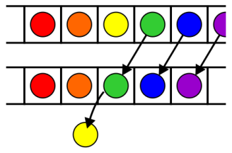
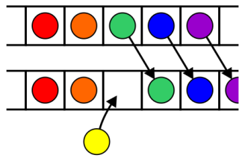
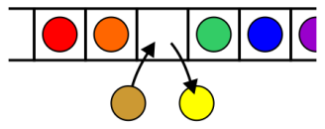
Operations
Operations at the k^{th} entry of the list include:
Access to the object Erasing an object
Insertion of a new object Replacement of the object
Notes:
前面介绍过，所谓抽象类型实际上包括了两个要素
一是这个类型所包含的数据对象集是什么：
对线性表来说，他的对象集是由n个元素组成的一个有序序列（元素具体类型 随意）
二是operation

Slide 21
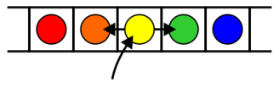
Operations
Given access to the k^{th} object, gain access to either the previous or next object
Given two abstract lists, we may want to
Concatenate the two lists
Determine if one is a sub-list of the other

Slide 22
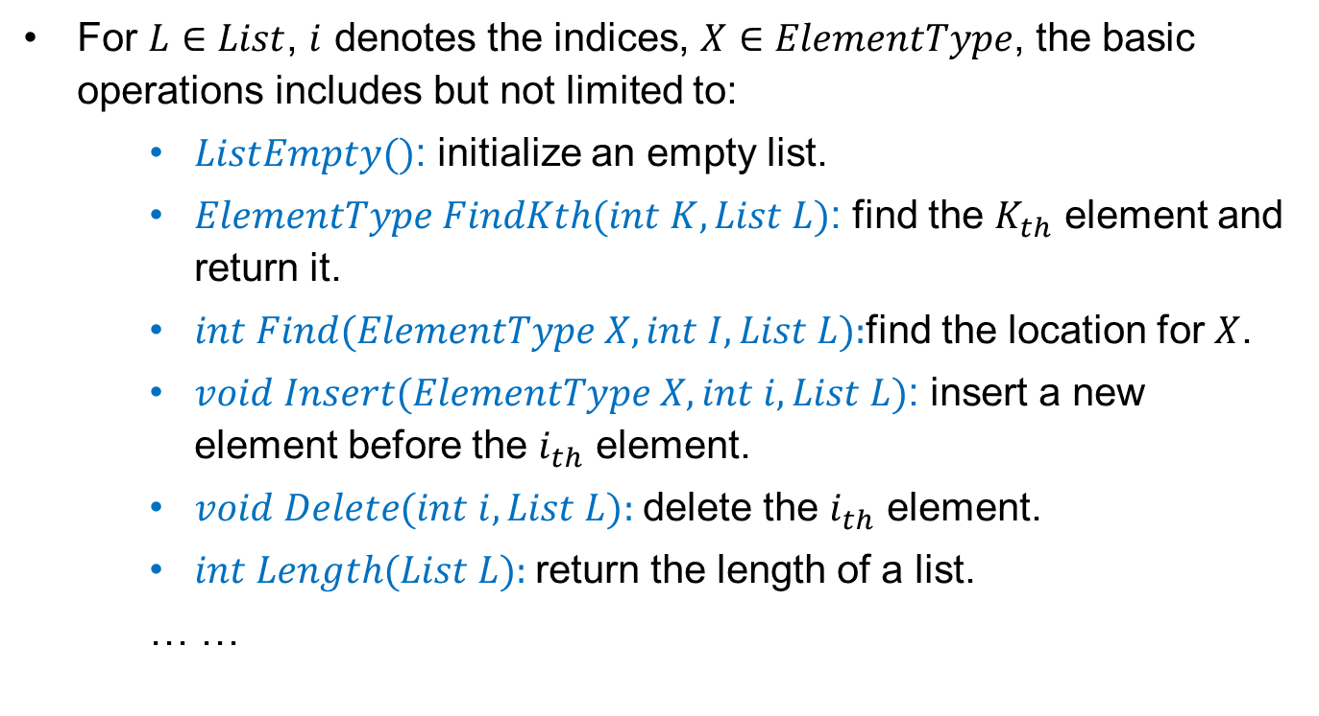
Operations
For $L∈List$, $i$ denotes the indices, $X∈ElementType$, the basic operations includes but not limited to:
$ListEmpty()$: initialize an empty list.
$ElementType FindKth(int K, List L)$: find the $K_{th}$ element and return it.
$int Find(ElementType X, int I, List L):$find the location for $X$.
$void Insert(ElementType X, int i, List L)$: insert a new element before the $i_{th}$ element.
$void Delete(int i, List L):$delete the $i_{th}$ element.
$int Length(List L):$return the length of a list.
… …
Notes:
查找的平均比较次数是n+1/2 运气好，第一个找到，比较1次，运气不好，最后一个找到，比较n次，平均是。。。

Slide 23














List based on array
$$Data$$
$$a_{1}$$
$$a_{2}$$
$$⋯$$
$$a_{i}$$
$$a_{i+1}$$
$$⋯$$
$$a_{n}$$
$$⋯$$
$Array$ indice
0
1
$$⋯$$
i-1
i
$$⋯$$
n-1
$$⋯$$
$MAXSIZE$-1
Last
Notes:
利用数组的联系存储空间顺序存放线性表的各元素
Last是目前数组最后一个元素所在的位置
如果要插入，要先判断表是否已满，然后从最后一个开始向后挪一个位置，平均时间 n/2
如果要删除，要先判断表是否为空，然后从删除的位置开始，一个个向前挪，最后last前进一个位置
如果查找，先判断表是否为空，
如果判断长度，只要看Last的位置就可以 长度是Last+1

Slide 24



























List based on array
O(n)
Insert element
$$Data$$
$$a_{1}$$
$$a_{2}$$
$$⋯$$
$$a_{i}$$
$$a_{i+1}$$
$$⋯$$
$$a_{n}$$
$$⋯$$
$Array$ indice
0
1
$$⋯$$
i-1
i
$$⋯$$
n-1
$$⋯$$
$MAXSIZE$-1
Last
Delete element
$$Data$$
$$a_{1}$$
$$a_{2}$$
$$⋯$$
$$a_{i}$$
$$a_{i+1}$$
$$⋯$$
$$a_{n}$$
$$⋯$$
$Array$ indice
0
1
$$⋯$$
i-1
i
$$⋯$$
n-1
$$⋯$$
$MAXSIZE$-1
Last
Notes:
利用数组的联系存储空间顺序存放线性表的各元素
Last是目前数组最后一个元素所在的位置
如果要插入，要先判断表是否已满，还要判断插入的位置对不对，是不是1到n+1之间，然后从最后一个开始向后挪一个位置，平均移动次数 n/2，整个算法的时间复杂度在
如果要删除，要先判断表是否为空，然后从删除的位置开始，一个个向前挪，最后last前进一个位置
如果查找，先判断表是否为空，然后顺序向后查找
如果判断长度，只要看Last的位置就可以 长度是Last+1

Slide 25
Abstract Strings
A specialization of an Abstract List is an Abstract String:
The entries are restricted to characters from a finite alphabet
This includes regular strings, e.g., “Hello world!”
The restriction using an alphabet emphasizes specific operations that would seldom be used otherwise
Substrings, matching substrings, string concatenations
It also allows more efficient implementations
String searching/matching algorithms
Regular expressions

Slide 26
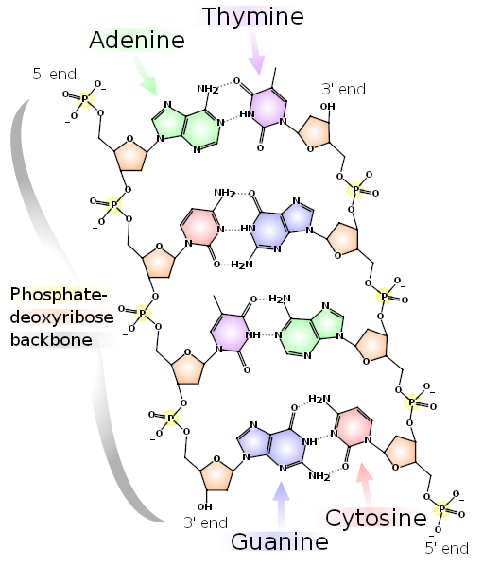
Abstract Strings
Strings also include DNA
The alphabet has 4 characters: A, C, G, and T
These are the nucleobases:
adenine, cytosine, guanine, and thymine
Bioinformatics today uses many of the algorithms traditionally restricted to computer science:
Dan Gusfield, Algorithms on Strings, Trees and Sequences: Computer Science and Computational Biology, Cambridge, 1997
http://books.google.ca/books?id=STGlsyqtjYMC
References:
http://en.wikipedia.org/wiki/DNA
http://en.wikipedia.org/wiki/Bioinformatics

Slide 27
Outline
List ADT
Linked list
Doubly linked list
Node-based storage with arrays
Application

Slide 28
Definition
A linked list is a data structure where each object is stored in a node
As well as storing data, the node must also contains a reference/pointer to the node containing the next item of data
L
42
95
70
81
∅
Notes:
也可以用链表来实现
逻辑上相连的两个元素用链连接起来,不要求逻辑上相邻的两个元素在物理上也相邻；通过“链”建立起数据之间的联系。
与之相对比的就是我们刚刚用数组表示的线性结构，两个相邻的元素不仅在逻辑上相邻，在物理结构上也相邻，导致插入删除，都需要把相邻的元素像后或者向前挪动。
插入删除不需要移动数据元素，只需要修改“链”。

Slide 29
Node Class
L
42
95
70
81
∅
The node must store data and a pointer:
class Node {
private:
int element;
Node *next_node;
public:
Node( int = 0, Node * = nullptr );
int retrieve() const;
Node *next() const;
};
Notes:
每个节点是一个结构，这个结构里面至少有两个分量，一个分量代表这个节点所对应的的数据，另外一个代表下一个节点的位置，也就是Next这样一个指针
头结点不包含数据，只有一个指针
尾结点，没有next，指向null

Slide 30
Node Constructor
The constructor assigns the two member variables based on the arguments
Node::Node( int e, Node *n ):
element( e ),
next_node( n ) {
// empty constructor
}
The default values are given in the class definition:
Node( int = 0, Node * = nullptr );

Slide 31
Accessors
The two member functions are accessors which simply return the element and the next_node member variables, respectively
int Node::retrieve() const { return element;
}
Node *Node::next() const {
return next_node;
}
Notes:
Member functions that do not change the object acted upon are variously called accessors, readonly functions, inspectors, and, when it involves simply returning a member variable, getters

Slide 32
Linked List Class
Because each node in a linked lists refers to the next, the linked list class need only link to the first node in the list
The linked list class requires member variable: a pointer to a node
class List {
private:
Node *list_head;
// ...
};

Slide 33
Structure
Let us look at the internal representation of a linked list
Suppose we want a linked list to store the values
42 95 70 81
in this order

Slide 34
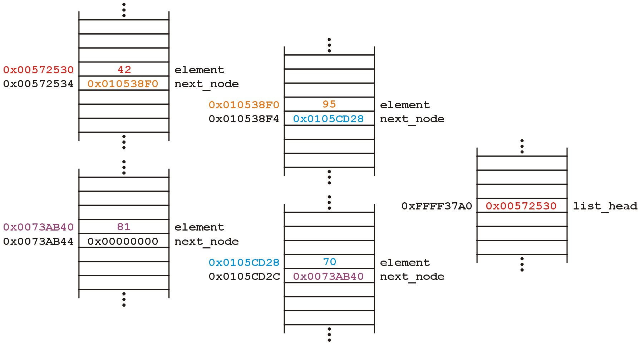
Structure
A linked list uses linked allocation, and therefore each node may appear anywhere in memory:
Linked List Object

Slide 35
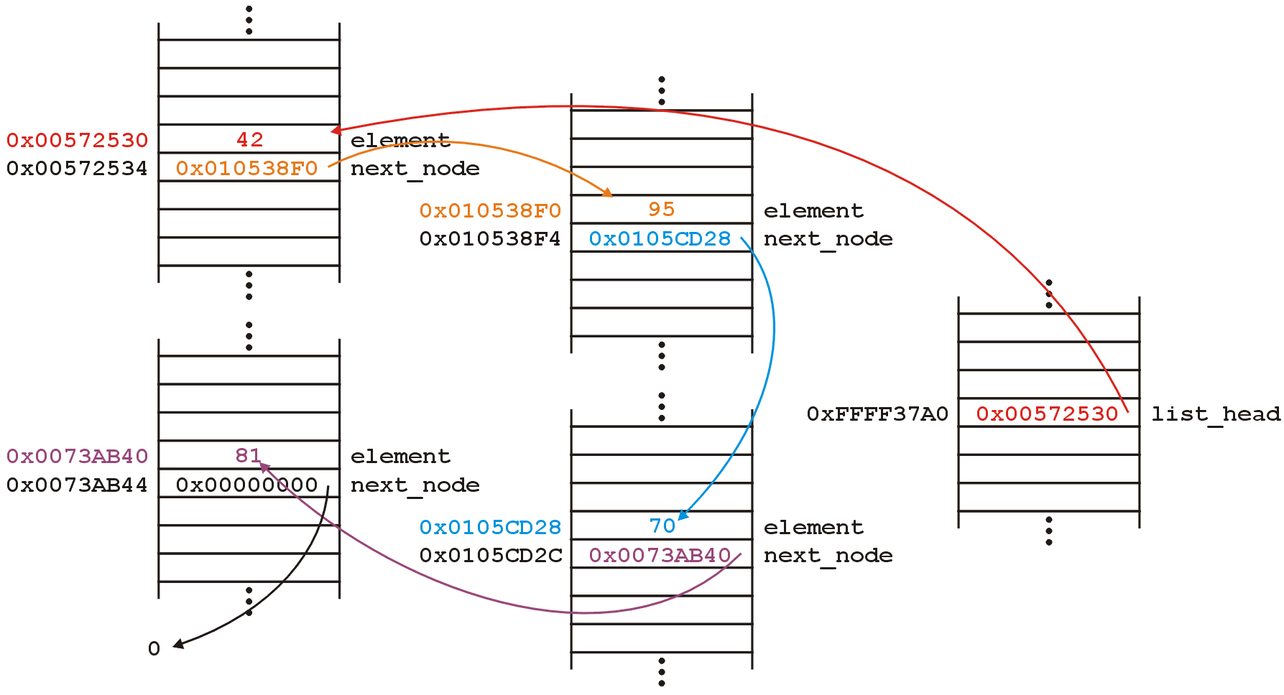
Structure
The next_node pointers store the addresses of the next node in the list

Slide 36
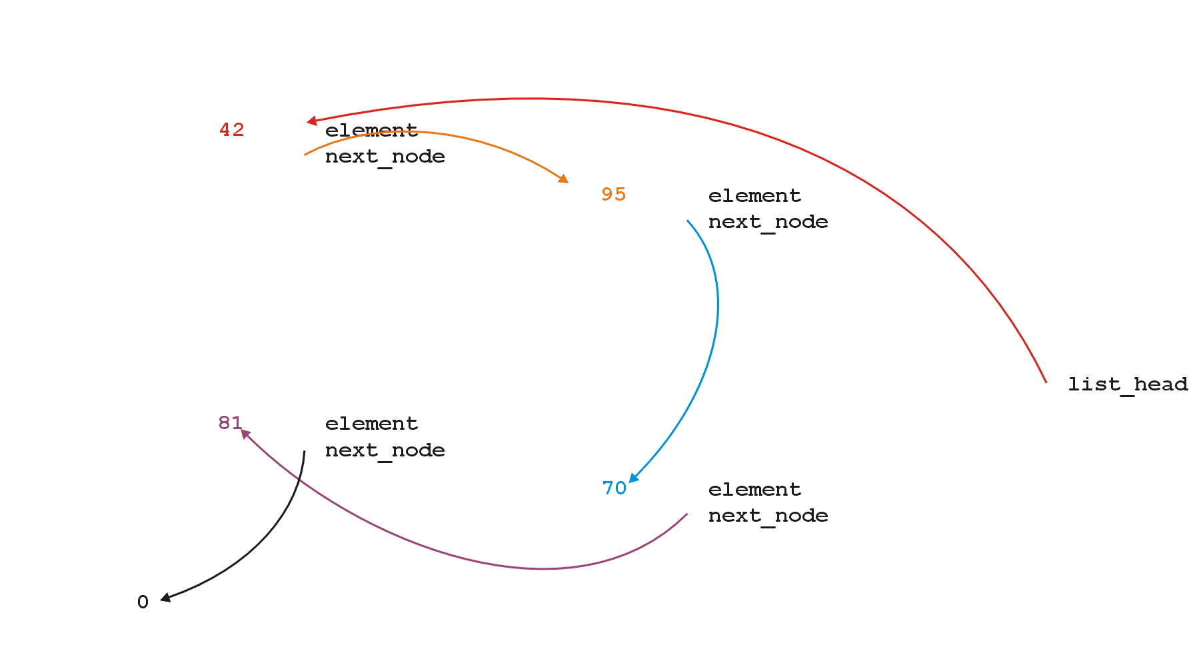
Structure
Because the addresses are arbitrary, we can remove that information:

Slide 37
Structure
We will clean up the representation as follows:
We do not specify the addresses because they are arbitrary and:
The contents of the circle is the element
The next_node pointer is represented by an arrow
list_

Slide 38
Operations
First, we want to create a linked list
We also want to be able to:
insert into,
access, and
erase from
the elements stored in the linked list
Notes:
插入，访问，删除

Slide 39
Operations
We can do them with the following operations:
Adding, retrieving, or removing the value at the front of the linked list
void push_front( int );
int front() const;
void pop_front();
We may also want to access the head of the linked list
Node *head() const;
Notes:
Head（）取表头的指针
Front（）取表头的数据

Slide 40
Operations
All these operations relate to the first node of the linked list
We may want to perform operations on an arbitrary node of the linked list, for example:
Find the number of instances of an integer in the list:
int count( int ) const;
Remove all instances of an integer from the list:
int erase( int );
Notes:
Count 求某个X在表中出现的次数
Erase 删除整个表

Slide 41
Linked Lists
Additionally, we may wish to check the state:
Is the linked list empty?
bool empty() const;
How many objects are in the list?
int size() const;
The list is empty when the list_head pointer is set to nullptr
Notes:
Empty（）判断表是否为空
Size 求表长

Slide 42
Linked Lists
Consider this simple (but incomplete) linked list class:
class List {
private:
Node *list_head;
public:
List();
// Accessors
bool empty() const;
int size() const;
int front() const;
Node *head() const;
int count( int ) const;
// Mutators
void push_front( int );
int pop_front();
int erase( int );
};

Slide 43
The Constructor
In the constructor, we assign list_head the value nullptr
List::List():list_head( nullptr ) {
// empty constructor
}
We will always ensure that when a linked list is empty, the list head is assigned nullptr

Slide 44
bool empty() const
Starting with the easier member functions:
bool List::empty() const {
if ( list_head == nullptr ) {
return true;
} else {
return false;
}
}
Better yet:
bool List::empty() const {
return ( list_head == nullptr );
}

Slide 45
Node *head() const
The member function Node *head() const is easy enough to implement:
Node *List::head() const {
return list_head;
}
This will always work: if the list is empty, it will return nullptr

Slide 46
int front() const
To get the first element in the linked list, we must access the node to which the list_head is pointing
Because we have a pointer, we must use the -> operator to call the member function:
int List::front() const {
return head()->retrieve();
}

Slide 47
int front() const
What if the list is empty?
If we tried to access a member function of a pointer set to nullptr, we would access restricted memory and the OS would terminate the running program

Slide 48
int front() const
Instead, we can use an exception handling mechanism where we thrown an exception
We define a class
class underflow {
// emtpy
};
and then we throw an instance of this class:
throw underflow();

Slide 49
int front() const
Thus, the full function is
int List::front() const {
if ( empty() ) {
throw underflow(); }
return head()->retrieve();
}

Slide 50
int front() const
Why is emtpy() better than
int List::front() const {
if ( list_head == nullptr ) {
throw underflow(); }
return list_head->element;
}
Two benefits:
More readable
If the implementation changes we do nothing

Slide 51


void push_front( int )
Next, let us add an element to the list
If it is empty, we start with:
and, if we try to add 81, we should end up with:

Slide 52
void push_front( int )
We must:
create a new node which:
stores the value 81, and
is pointing to 0
assign its address to list_head
We can do this as follows:
list_head = new Node( 81, nullptr );
Notes:
We could also use the default value...
新的节点储存81，并指向表尾

Slide 53
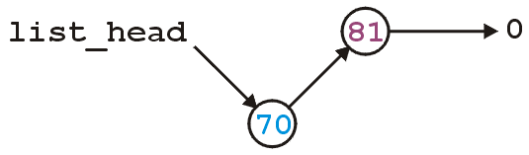
void push_front( int )
Suppose however, we already have a non-empty list
Adding 70, we want:

Slide 54
void push_front( int )
To achieve this, we must we must create a new node which:
stores the value 70, and
is pointing to the current list head
we must then assign its address to list_head
We can do this as follows:
list_head = new Node( 70, list_head );
Notes:
新节点指向插入前list_head指向的节点（这里假设是81，而不是表尾）
新的list_head指向新的节点

Slide 55
void push_front( int )
Thus, our implementation could be:
void List::push_front( int n ) {
if ( empty() ) {
list_head = new Node( n, nullptr );
} else {
list_head = new Node( n, head() );
}
}
Notes:
将空表和有内容表在表头插入的两种情况合在一起

Slide 56
void push_front( int )
We could, however, note that when the list is empty, list_head == 0, thus we could shorten this to:
void List::push_front( int n ) {
list_head = new Node( n, list_head );
}
Notes:
发现我一定是个sb写的那么麻烦，因为如果是空表list_head指向的就是表尾，所以不需要做这种区分，只要让新的节点next替代list_head就可以

Slide 57
void push_front( int )
Are we allowed to do this?
void List::push_front( int n ) {
list_head = new Node( n, head() );
}
Yes: the right-hand side of an assignment is evaluated first
The original value of list_head is accessed first before the function call is made

Slide 58
void push_front( int )
Question: does this work?
void List::push_front( int n ) {
Node new_node( n, head() );
list_head = &new_node;
}
Why or why not? What happens to new_node?
How does this differ from
void List::push_front( int n ) {
Node *new_node = new Node( n, head() );
list_head = new_node;
}
Notes:
第一个没有给new node 申请空间，出了这个函数就被destryed，第二个做了new申请，占用了需要释放的空间

Slide 59

int pop_front()
Erasing from the front of a linked list is even easier:
We assign the list head to the next pointer of the first node
Graphically, given:
we want:

Slide 60
int pop_front()
Easy enough:
int List::pop_front() {
int e = front();
list_head = head()->next();
return e;
}
Unfortunately, we have some problems:
The list may be empty
We still have the memory allocated for the node containing 70

Slide 61
int pop_front()
Does this work?
int List::pop_front() {
if ( empty() ) {
throw underflow();
}
int e = front();
delete head();
list_head = head()->next();
return e;
}

Slide 62
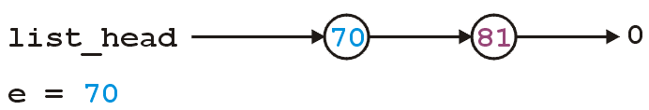
int pop_front()
int List::pop_front() {
if ( empty() ) {
throw underflow();
}
int e = front();
delete head();
list_head = head()->next();
return e;
}

Slide 63
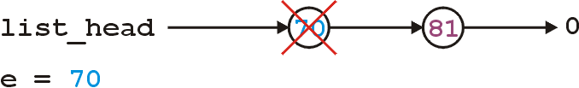
int pop_front()
int List::pop_front() {
if ( empty() ) {
throw underflow();
}
int e = front();
delete head();
list_head = head()->next();
return e;
}

Slide 64
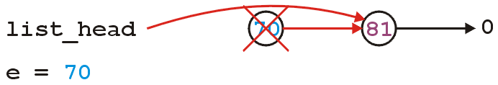
int pop_front()
int List::pop_front() {
if ( empty() ) {
throw underflow();
}
int e = front();
delete head();
list_head = head()->next();
return e;
}
Any problem with the above code?
Notes:
如果不引入一个临时变量，e只能保留data部分，删除head（）指针后，指向81的指针就消失了，新的list_head无法指向81.
如果反过来，会删掉81的指针

Slide 65
int pop_front()
The correct implementation assigns a temporary pointer to point to the node being deleted:
int List::pop_front() {
if ( empty() ) {
throw underflow();
}
int e = front();
Node *ptr = list_head;
list_head = list_head->next();
delete ptr;
return e;
}
Notes:
所以一定需要一个临时节点，把目前head（）取出，把list_head指向下一个节点，然后删除临时节点，并返回70

Slide 66
Stepping through a Linked List
The next step is to look at member functions which potentially require us to step through the entire list:
int size() const;
int count( int ) const;
int erase( int );
The second counts the number of instances of an integer, and the last removes the nodes containing that integer
Notes:
Size（）求表长，第一个方法就是遍历链表，比较简单，复杂度O（n）。一开始设一个临时指针P指向链表头，加一个计数器i，计算循环数，循环里面每一次把p挪到下一个节点的位置，直到P指向Null，循环结束，返回计数器的值。
Erase（）删除链表中所有某个特定的数字

Slide 67
Stepping through a Linked List
The process of stepping through a linked list can be thought of as being analogous to a for-loop:
We initialize a temporary pointer with the list head
We continue iterating until the pointer equals nullptr
With each step, we set the pointer to point to the next object

Slide 68
Stepping through a Linked List
Thus, we have:
for ( Node *ptr = head(); ptr != nullptr; ptr = ptr->next() ) {
// do something
// use ptr->fn() to call member functions
// use ptr->var to assign/access member variables
}

Slide 69
Stepping through a Linked List
Analogously:
for ( Node *ptr = head(); ptr != nullptr; ptr = ptr->next() )
for ( int i = 0; i != N; ++i )

Slide 70
int count( int ) const
To implement int count(int) const, we simply check if the argument matches the element with each step
Each time we find a match, we increment the count
When the loop is finished, we return the count
The size function is simplification of count
Notes:
，也需要遍历，和上面的方法相似，数组表示的线性表这个操作很简单，循环两个条件，p！=null，没结束，i==K。循环结束需要判断，是哪个情况，返回不同的值。
Count（）按值查找查找某个数，并计算出现了几次
每次找到一个匹配，计数器加一
循环结束（指向表尾），返回计数器的值
求表长是count（）的简化版。

Slide 71
int count( int ) const
The implementation:
int List::count( int n ) const {
int node_count = 0;
for ( Node *ptr = list(); ptr != nullptr; ptr = ptr->next() ) {
if ( ptr->retrieve() == n ) {
++node_count;
}
}
return node_count;
}

Slide 72
int erase( int )
To remove an arbitrary element, i.e., to implement int erase( int ), we must update the previous node
For example, given
if we delete 70, we want to end up with

Slide 73
Accessing Private Member Variables
Notice that the erase function must modify the member variables of the node prior to the node being removed
Thus, it must have access to the member variable next_node
We could supply the member function
void set_next( Node * );
however, this would be globally accessible
Possible solutions:
Friends
Nested classes
Inner classes (Java/C#)
Notes:
和pop_front相似，吧head（）变成set_next(),必须借助一个临时

Slide 74
C++ Friends
In C++, you explicitly break encapsulation by declaring the class List to be a friend of the class Node:
class Node {
Node *next() const;
// ... declaration ...
friend class List;
};
Now, inside erase (a member function of List), you can modify all the member variables of any instance of the Node class

Slide 75
C++ Friends
For example, the erase member function could be implemented using the following code:
int List::erase( int n ) {
int node_count = 0;
// ...
for ( Node *ptr = head(); ptr != nullptr; ptr = ptr->next() ) {
// ...
if ( some condition ) {
ptr->next_node = ptr->next()->next();
// ...
++node_count;
}
}
return node_count;
}

Slide 76
Destructor
We dynamically allocated memory each time we added a new int into this list
Suppose we delete a list before we remove everything from it
This would leave the memory allocated with no reference to it

Slide 77
Destructor
Thus, we need a destructor:
class List {
private:
Node *list_head;
public:
List();
~List();
// ...etc...
};

Slide 78
Destructor
The destructor has to delete any memory which had been allocated but has not yet been deallocated
This is straight-forward enough:
while ( !empty() ) {
pop_front();
}

Slide 79
Making Copies
Is this sufficient for a linked list class?
Initially, it may appear yes, but we now have to look at how C++ copies objects during:
Passing by value (making a copy), and
Assignment

Slide 80
Pass by Value
Recall that when you pass an integer to a function, a copy is made, so any changes to that parameter does not affect the original:
#include <iostream>
void increment( int n ) {
++n;
}
int main() {
int counter = 0;
increment( counter );
std::cout << counter << std::endl; // counter is still 0
}

Slide 81
Pass by Reference
If you want to change the value, you can pass by reference:
#include <iostream>
void increment( int &n ) {
++n;
}
int main() {
int counter = 0;
increment( counter );
std::cout << counter << std::endl; // counter is now 1
}

Slide 82
Pass by Pointer (C)
In C, you would pass the address of the object to change it:
#include <stdio.h>
void increment( int *pn ) {
++(*pn);
}
int main() {
int counter = 0;
increment( &counter );
printf( "%d", counter ); // counter is now 1
}

Slide 83
Modifying Arguments
Pass by reference could be used to modify a list
void reverse( List &list ) {
List tmp;
while ( !list.empty() ) {
tmp.push_front( ls.pop_front() );
}
// All the member variables of 'list' and 'tmp' are swapped
std::swap( list, tmp );
// The memory for 'tmp' will be cleaned up
}

Slide 84
Modifying Arguments
If you wanted to prevent the argument from being modified, you could declare it const:
double average( List const &ls, int min, int max ) {
double sum = 0, count = 0;
for ( Node *ptr = head(); ptr != nullptr; ptr = ptr->next() ) {
sum += ptr->retrieve();
++count;
}
return sum/count;
}
Note: this reveals a weakness in our model—we will discuss iterators later…

Slide 85
Modifying Arguments
You want to pass a copy of a linked list to a function—where the function may modify the copy, but the original list shall be unchanged.
void func( List ls ) {
// The compiler creates a new instance and copies the values
// The function does something with 'ls'
// The compiler ensures the destructor is called on 'ls'
}
With the default copy constructor, all the member variables are simply copied over into the new instance of the class

Slide 86
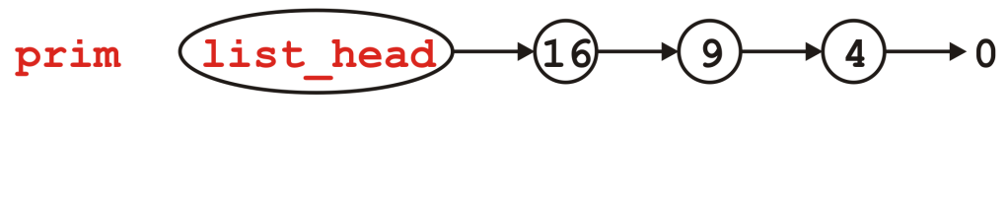
Modifying Arguments
void send_copy( List ls ) {
// The compiler creates a new instance and copies the values
// The function does something with 'ls'
// The compiler ensures the destructor is called on 'ls'
}
int main() {
List prim;
for ( int i = 2; i <= 4; ++i ) {
prim.push_front( i*i );
}
send_copy( prim );
std::cout << prim.empty() << std::endl;
return 0;
}
First, the list prim is created and three elements are pushed onto it

Slide 87
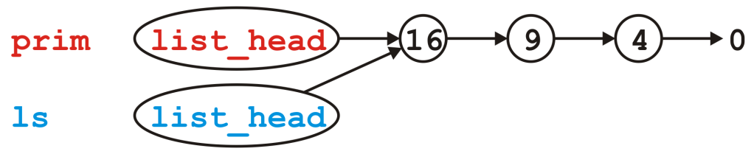
Modifying Arguments
void send_copy( List ls ) {
// The compiler creates a new instance and copies the values
// The function does something with 'ls'
// The compiler ensures the destructor is called on 'ls'
}
int main() {
List prim;
for ( int i = 2; i <= 4; ++i ) {
prim.push_front( i*i );
}
send_copy( prim );
std::cout << prim.empty() << std::endl;
return 0;
}
Next, we call send_copy and assigns a copy of prim to ls. The default is to copy member variables:
ls.list_head = prim.list_head

Slide 88
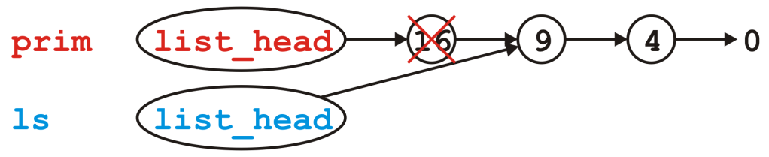
Modifying Arguments
void send_copy( List ls ) {
// The compiler creates a new instance and copies the values
// The function does something with 'ls'
// The compiler ensures the destructor is called on 'ls'
}
int main() {
List prim;
for ( int i = 2; i <= 4; ++i ) {
prim.push_front( i*i );
}
send_copy( prim );
std::cout << prim.empty() << std::endl;
return 0;
}
When send_copy returns, the destructor is called on ls

Slide 89
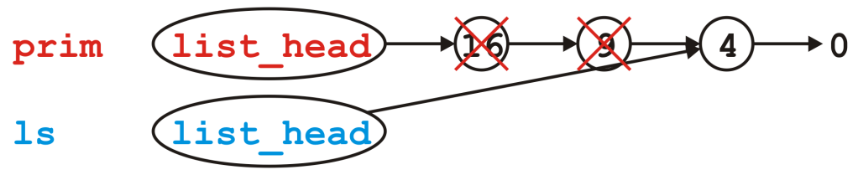
Modifying Arguments
void send_copy( List ls ) {
// The compiler creates a new instance and copies the values
// The function does something with 'ls'
// The compiler ensures the destructor is called on 'ls'
}
int main() {
List prim;
for ( int i = 2; i <= 4; ++i ) {
prim.push_front( i*i );
}
send_copy( prim );
std::cout << prim.empty() << std::endl;
return 0;
}
When send_copy returns, the destructor is called on ls

Slide 90
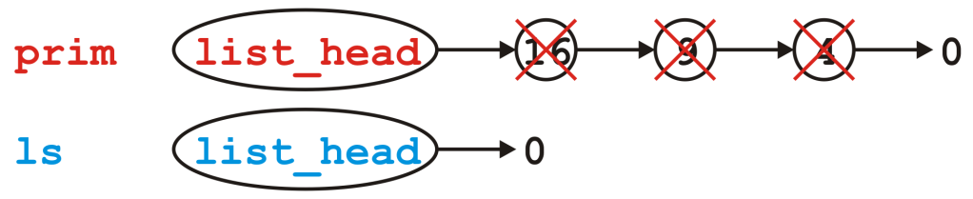
Modifying Arguments
void send_copy( List ls ) {
// The compiler creates a new instance and copies the values
// The function does something with 'ls'
// The compiler ensures the destructor is called on 'ls'
}
int main() {
List prim;
for ( int i = 2; i <= 4; ++i ) {
prim.push_front( i*i );
}
send_copy( prim );
std::cout << prim.empty() << std::endl;
return 0;
}
When send_copy returns, the destructor is called on ls

Slide 91
Modifying Arguments
void send_copy( List ls ) {
// The compiler creates a new instance and copies the values
// The function does something with 'ls'
// The compiler ensures the destructor is called on 'ls'
}
int main() {
List prim;
for ( int i = 2; i <= 4; ++i ) {
prim.push_front( i*i );
}
send_copy( prim );
std::cout << prim.empty() << std::endl;
return 0;
}
Back in main(), prim.list_head still stores the address of the Node containing 16, memory that has since been returned to the OS

Slide 92
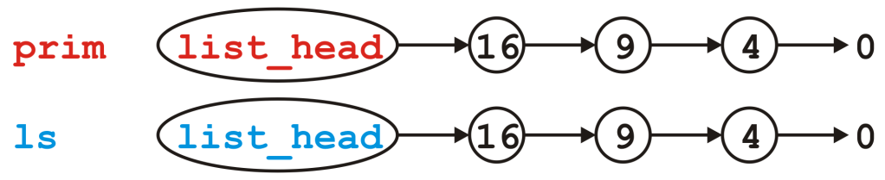
Modifying Arguments
What do we really want?
We really want a copy of the linked list
If this copy is modified, it leaves the original unchanged

Slide 93
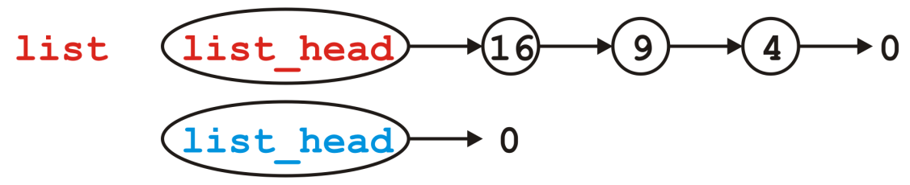
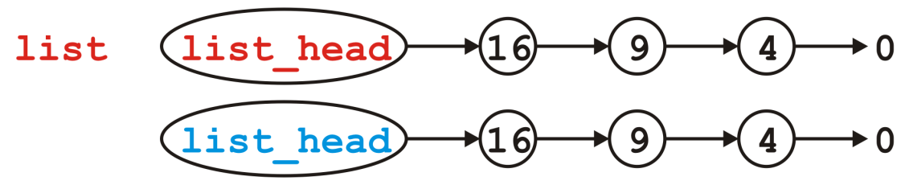
Copy Constructor
You can modify how copies are made by defining a copy constructor
List::List( List const &list ):list_head( nullptr ) {
// Make a copy of list
}
We now want to go from
to

Slide 94
Copy Constructor
Naïvely, we step through list and call push_front( int ):
List::List( List const &list ):list_head( nullptr ) {
for ( Node *ptr = list.head(); ptr != nullptr; ptr = ptr->next() ) {
push_front( ptr->retrieve() );
}
}
Does this work?
How could we make this work?
We need a push_back( int ) member function:
List::List( List const &list ):list_head( nullptr ) {
for ( Node *ptr = list.head(); ptr != nullptr; ptr = ptr->next() ) {
push_back( ptr->retrieve() );
}
}

Slide 95
Copy Constructor
Unfortunately, to make push_back( int ) more efficient, we need a pointer to the last node in the linked list
We require a list_tail member variable
Otherwise, push_back( int ) becomes a Θ(n) function
This would make the copy constructor Θ(n²)
In Project 1, you will define and use the member variable list_tail

Slide 96
Copy Constructor
First, make life simple: if list is empty, we are finished, so return
List::List( List const &list ):list_head( nullptr ) {
if ( list.empty() ) {
return;
}
}

Slide 97
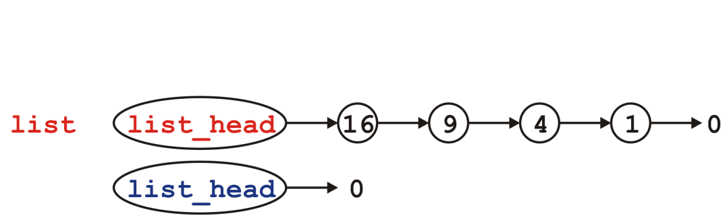
Copy Constructor
Otherwise, the list being copied is not empty…
List::List( List const &list ):list_head( nullptr ) {
if ( list.empty() ) {
return;
}
}

Slide 98
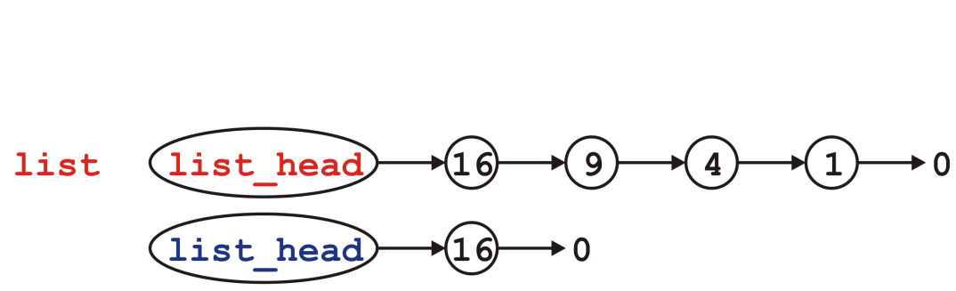
Copy Constructor
Copy the first node—we no longer modifying list_head
List::List( List const &list ):list_head( nullptr ) {
if ( list.empty() ) {
return;
}
push_front( list.front() );
}

Slide 99
Copy Constructor
We will need to loop through the list… How about a for loop?
List::List( List const &list ):list_head( nullptr ) {
if ( list.empty() ) {
return;
}
push_front( list.front() );
}

Slide 100
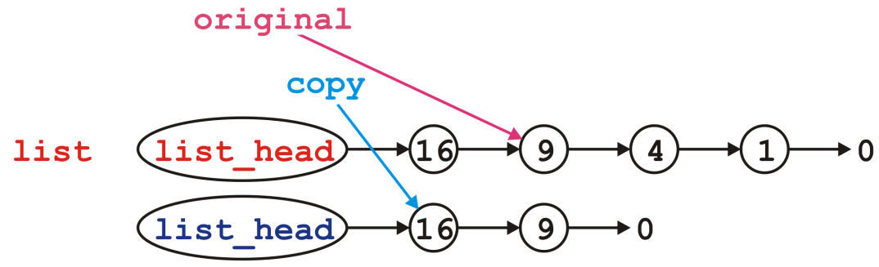
Copy Constructor
We modify the next pointer of the node pointed to by copy
List::List( List const &list ):list_head( nullptr ) {
if ( list.empty() ) {
return;
}
push_front( list.front() );
for (
Node *original = list.head()->next(), *copy = head();
original != nullptr;
original = original->next(), copy = copy->next()
) {
copy->next_node = new Node( original->retrieve(), nullptr );
}
}

Slide 101
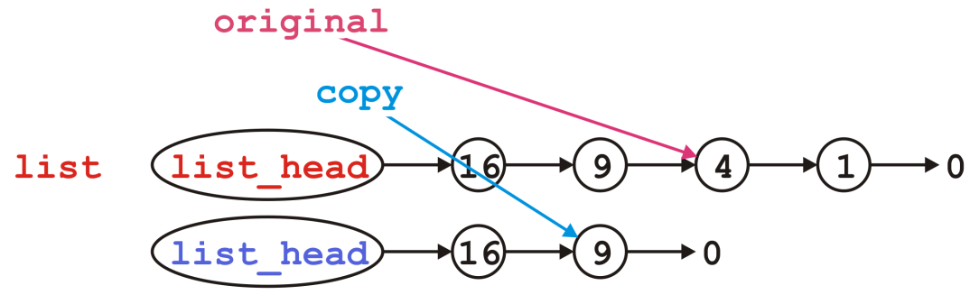
Copy Constructor
Then we move each pointer forward:
List::List( List const &list ):list_head( nullptr ) {
if ( list.empty() ) {
return;
}
push_front( list.front() );
for (
Node *original = list.head()->next(), *copy = head();
original != nullptr;
original = original->next(), copy = copy->next()
) {
copy->next_node = new Node( original->retrieve(), nullptr );
}
}

Slide 102
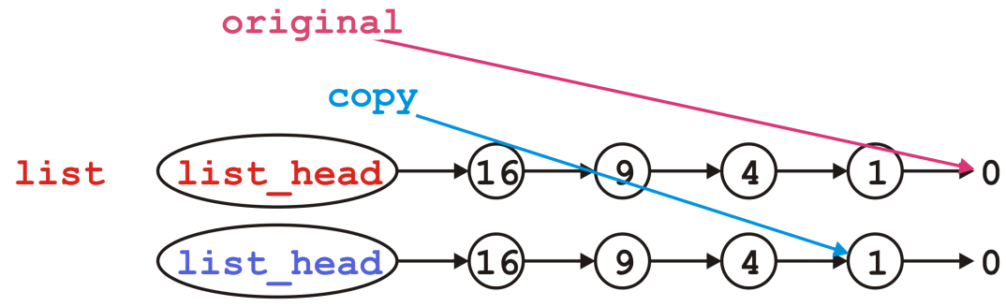
Copy Constructor
We’d continue copying until we reach the end
List::List( List const &list ):list_head( nullptr ) {
if ( list.empty() ) {
return;
}
push_front( list.front() );
for (
Node *original = list.head()->next(), *copy = head();
original != nullptr;
original = original->next(), copy = copy->next()
) {
copy->next_node = new Node( original->retrieve(), nullptr );
}
}

Slide 103
Assignment
What about assignment?
Suppose you have linked lists:
List lst1, lst2;
lst1.push_front( 35 );
lst1.push_front( 18 );
lst2.push_front( 94 );
lst2.push_front( 72 );

Slide 104
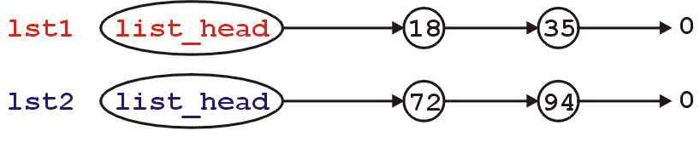
Assignment
This is the current state:
Consider an assignment:
lst2 = lst1;
What do we want? What do we actually do?

Slide 105
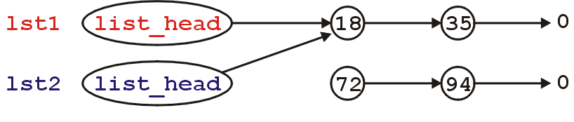
Assignment
The default behavior: the member variables of this class are copied over
It is equivalent to writing:
lst2.list_head = lst1.list_head;
Graphically:

Slide 106
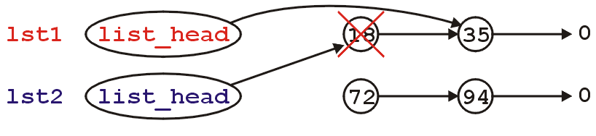
Assignment
What’s wrong with this picture?
We no longer have links to either of the nodes storing 72 or 94 (memory leak)
Also, suppose we call the member function
lst1.pop_front();
lst2 is now invalid

Slide 107
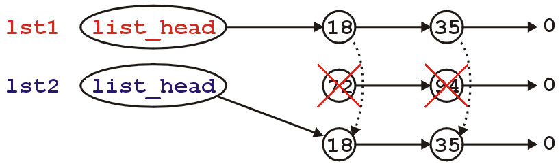
Assignment
Like making copies, we must have a reasonable means of assigning
Starting with
We need to erase the content of lst2 and copy over the nodes in lst1

Slide 108
Assignment
First, to overload the assignment operator, we must overload the function named operator =
This is a how you indicate to the compiler that you are overloading the assignment (=) operator
The signature is:
List &operator = ( List );

Slide 109
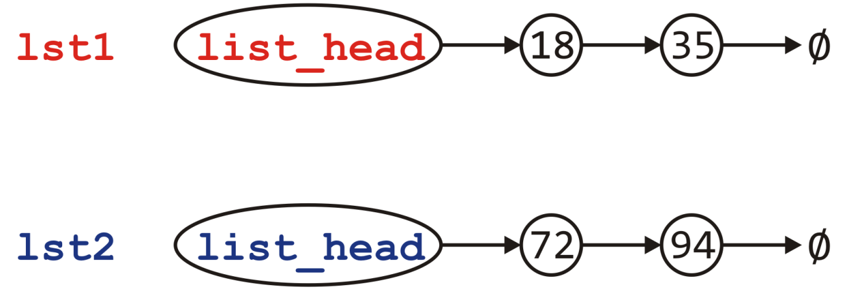
Assignment
Visually, we are doing the following:

Slide 110
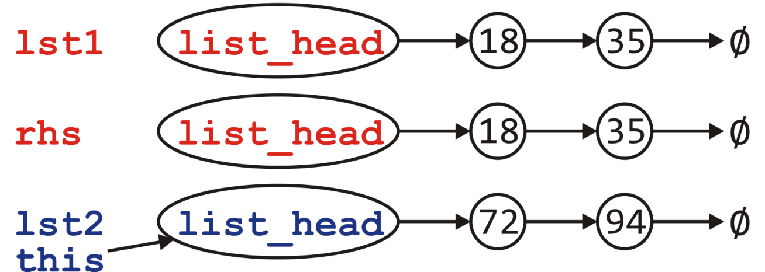
Assignment
Visually, we are doing the following:
Call the copy constructor to create rhs

Slide 111
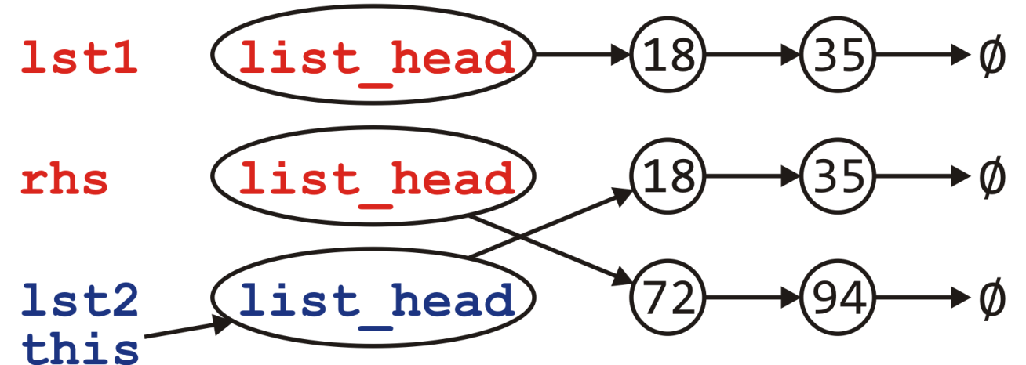
Assignment
Visually, we are doing the following:
Call the copy constructor to create rhs
Swapping the member variables of *this and rhs

Slide 112
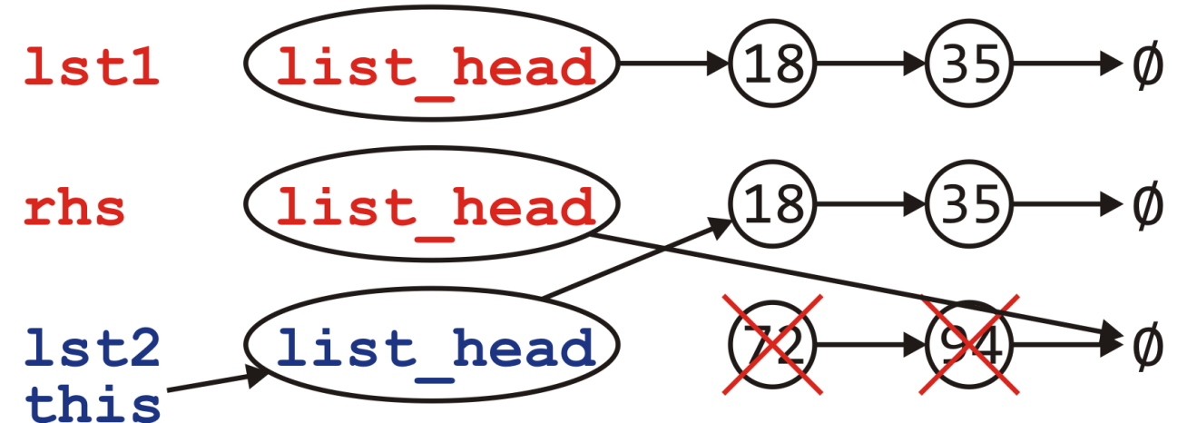
Assignment
Visually, we are doing the following:
Call the copy constructor to create rhs
Swapping the member variables of *this and rhs
The destructor is called on rhs

Slide 113
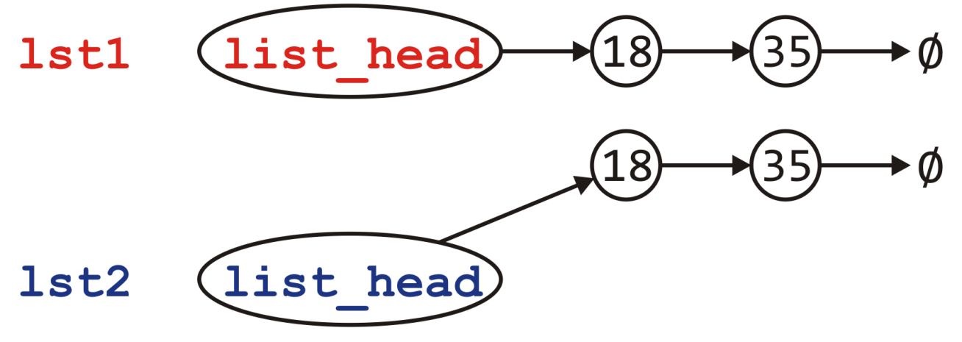
Assignment
Visually, we are doing the following:
Call the copy constructor to create rhs
Swapping the member variables of *this and rhs
The destructor is called on rhs

Slide 114
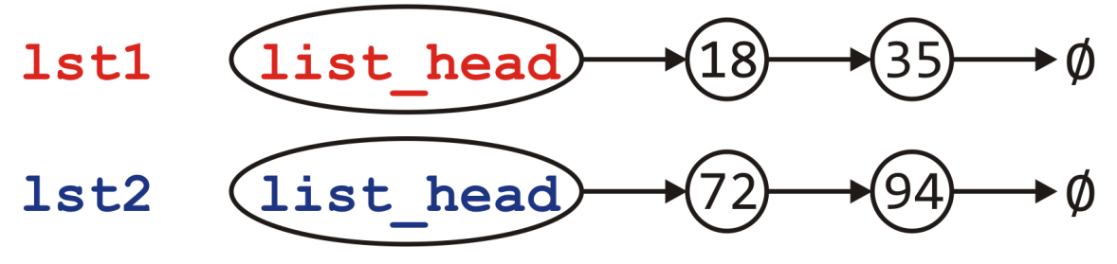
Assignment
Can we do better?
Consider the calls to new and delete
Each of these is very expensive…
Would it not be better to reuse the nodes if possible?
Notes:
Reference: Howard Hinnant

Slide 115
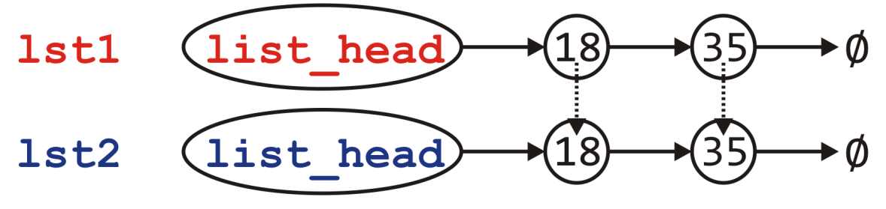
Assignment
Can we do better?
Consider the calls to new and delete
Each of these is very expensive…
Would it not be better to reuse the nodes if possible?
No calls to new or delete
Notes:
Reference: Howard Hinnant

Slide 116
Assignment
What is the plan?
If the right-hand side is empty, it’s straight-forward:
Just empty this list
Otherwise, step through the right-hand side list and for each node there
If there is a corresponding node in this, copy over the value, else
There is no corresponding node; create a new node and append it
If there are any nodes remaining in this, delete them

Slide 117
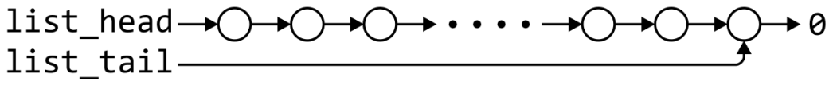
Linked list
 | Front/1st node | k^{th} node | Back/n^{th} node
Find | Θ(1) | Ο(n)* | Θ(1)
Insert Before | Θ(1) | Ο(n)* | Θ(n)
Insert After | Θ(1) | Θ(1)* | Θ(1)
Replace | Θ(1) | Θ(1)* | Θ(1)
Erase | Θ(1) | Ο(n)* | Θ(n)
Next | Θ(1) | Θ(1)* | n/a
Previous | n/a | Ο(n)* | Θ(n)
* These assume we have already accessed the k^{th} entry—an O(n) operation
Assume we have a tail pointer

Slide 118
Linked list
 | Front/1st node | k^{th} node | Back/n^{th} node
Find | Θ(1) | Ο(n)* | Θ(1)
Insert Before | Θ(1) | Θ(1)* | Θ(1)
Insert After | Θ(1) | Θ(1)* | Θ(1)
Replace | Θ(1) | Θ(1)* | Θ(1)
Erase | Θ(1) | Θ(1)* | Θ(n)
Next | Θ(1) | Θ(1)* | n/a
Previous | n/a | Ο(n)* | Θ(n)
By replacing the value in the node in question, we can speed things up
Assume we have a tail pointer

Slide 119
Outline
List ADT
Linked list
Doubly linked list
Node-based storage with arrays
Application

Slide 120
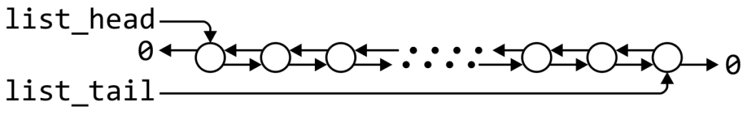
Doubly linked lists
 | Front/1st node | k^{th} node | Back/n^{th} node
Find | Θ(1) | Ο(n)* | Θ(1)
Insert Before | Θ(1) | Θ(1)* | Θ(1)
Insert After | Θ(1) | Θ(1)* | Θ(1)
Replace | Θ(1) | Θ(1)* | Θ(1)
Erase | Θ(1) | Θ(1)* | Θ(1)
Next | Θ(1) | Θ(1)* | n/a
Previous | n/a | Θ(1)* | Θ(1)
* These assume we have already accessed the k^{th} entry—an O(n) operation

Slide 121
Memory usage versus run times
Using a doubly linked list requires Θ(n) additional memory, but it speeds up many operations

Slide 122
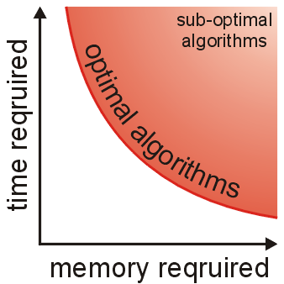
Memory usage versus run times
In general, there is an interesting relationship between memory and time efficiency
For a data structure/algorithm:
Improving the run time usually requires more memory
Reducing the required memory usually requires more run time
Notes:
As well as determining run times, we are also interested in memory usage

Slide 123
Memory usage versus run times
Warning: programmers often mistake this to suggest that given any solution to a problem, any solution which may be faster must require more memory
This guideline not true in general: there may be different data structures and/or algorithms which are both faster and require less memory
This requires thought and research

Slide 124
Outline
List ADT
Linked list
Doubly linked list
Node-based storage with arrays
Application

Slide 125
The issue
A significant issue with linked lists: node-based data structures require Θ(n) calls to new
Each new operation requires a call to the operating system requesting a memory allocation

Slide 126
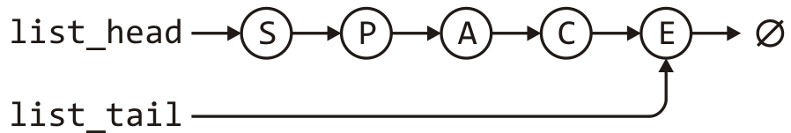
Using an array?
Suppose we store this linked list in an array?
list_head = 5;
list_tail = 2;
0 | 1 | 2 | 3 | 4 | 5 | 6 | 7
A |  | E | P |  | S | C
6 |  | -1 | 0 |  | 3 | 2

Slide 127
Using an array?
Rather than using, -1, use a constant assigned that value
This makes reading your code easier
list_head = 5;
list_tail = 2;
0 | 1 | 2 | 3 | 4 | 5 | 6 | 7
A |  | E | P |  | S | C
6 |  | NULLPTR | 0 |  | 3 | 2

Slide 128
A solution
To achieve this, we must create an array of objects that:
Store the value
Store the array index where the next entry is stored
template <typename Type>
class Single_node {
private:
Type element;
int next_node;
public:
Type retrieve() const;
int next() const;
};

Slide 129
A solution
Now, memory allocation is done once in the constructor:
template <typename Type>
class Single_list {
private:
int list_capacity;
int list_head;
int list_tail;
int list_size;
Single_node<Type> *node_pool;
static const int NULLPTR;
public:
Single_list( int = 16 );
// member functions
};
const int Single_list::NULLPTR = -1;
template <typename Type>
Single_list<Type>::Single_list( int n ):
list_capacity( n ),
list_head( NULLPTR ),
list_tail( NULLPTR ),
list_size( 0 ),
node_pool( new Single_node<Type>[n] ) {
// Empty constructor
}

Slide 130
A solution
Problem: when inserting a new element…
how do you know which cell to use?
Solution: keep a container (a stack) of the indices of unused nodes
list_head = 5;
list_tail = 2;
0 | 1 | 2 | 3 | 4 | 5 | 6 | 7
A |  | E | P |  | S | C
6 |  | NULLPTR | 0 |  | 3 | 2
stack_size = 3;
0 | 1 | 2 | 3 | 4 | 5 | 6 | 7
7 | 1 | 4

Slide 131
A solution
The stack would be initialized with all the entries
list_head = NULLPTR;
list_tail = NULLPTR;
0 | 1 | 2 | 3 | 4 | 5 | 6 | 7
stack_size = 8;
0 | 1 | 2 | 3 | 4 | 5 | 6 | 7
0 | 1 | 2 | 3 | 4 | 5 | 6 | 7

Slide 132
A solution
When pushing onto the list, the entry at the top of the stack is used
list_head = NULLPTR;
list_tail = NULLPTR;
0 | 1 | 2 | 3 | 4 | 5 | 6 | 7
stack_size = 8;
0 | 1 | 2 | 3 | 4 | 5 | 6 | 7
0 | 1 | 2 | 3 | 4 | 5 | 6 | 7

Slide 133
A solution
Now, push_front( 'O' ) would result in
list_head = 7;
list_tail = 7;
0 | 1 | 2 | 3 | 4 | 5 | 6 | 7
 |  |  |  |  |  |  | O
 |  |  |  |  |  |  | NULLPTR
stack_size = 7;
0 | 1 | 2 | 3 | 4 | 5 | 6 | 7
0 | 1 | 2 | 3 | 4 | 5 | 6 | 7

Slide 134
A solution
Suppose we call push_front( 'N' )
list_head = 7;
list_tail = 7;
0 | 1 | 2 | 3 | 4 | 5 | 6 | 7
 |  |  |  |  |  |  | O
 |  |  |  |  |  |  | NULLPTR
stack_size = 7;
0 | 1 | 2 | 3 | 4 | 5 | 6 | 7
0 | 1 | 2 | 3 | 4 | 5 | 6 | 7

Slide 135
A solution
Suppose we call push_front( 'N' )
The next node is at index 6
list_head = 6;
list_tail = 7;
0 | 1 | 2 | 3 | 4 | 5 | 6 | 7
 |  |  |  |  |  | N | O
 |  |  |  |  |  | 7 | NULLPTR
stack_size = 6;
0 | 1 | 2 | 3 | 4 | 5 | 6 | 7
0 | 1 | 2 | 3 | 4 | 5 | 6 | 7

Slide 136
A solution
Suppose we call push_back( 'R' )
list_head = 6;
list_tail = 7;
0 | 1 | 2 | 3 | 4 | 5 | 6 | 7
 |  |  |  |  |  | N | O
 |  |  |  |  |  | 7 | NULLPTR
stack_size = 6;
0 | 1 | 2 | 3 | 4 | 5 | 6 | 7
0 | 1 | 2 | 3 | 4 | 5 | 6 | 7

Slide 137
A solution
Suppose we call push_back( 'R' )
The next node is at index 5
list_head = 6;
list_tail = 5;
0 | 1 | 2 | 3 | 4 | 5 | 6 | 7
 |  |  |  |  | R | N | O
 |  |  |  |  | NULLPTR | 7 | 5
stack_size = 5;
0 | 1 | 2 | 3 | 4 | 5 | 6 | 7
0 | 1 | 2 | 3 | 4 | 5 | 6 | 7

Slide 138
A solution
Finally, suppose we call pop_front()
list_head = 6;
list_tail = 5;
0 | 1 | 2 | 3 | 4 | 5 | 6 | 7
 |  |  |  |  | R | N | O
 |  |  |  |  | NULLPTR | 7 | 5
stack_size = 5;
0 | 1 | 2 | 3 | 4 | 5 | 6 | 7
0 | 1 | 2 | 3 | 4 | 5 | 6 | 7

Slide 139
A solution
Finally, suppose we call pop_front()
The popped node is placed back into the stack
list_head = 7;
list_tail = 5;
0 | 1 | 2 | 3 | 4 | 5 | 6 | 7
 |  |  |  |  | R | N | O
 |  |  |  |  | NULLPTR | 7 | 5
stack_size = 6;
0 | 1 | 2 | 3 | 4 | 5 | 6 | 7
0 | 1 | 2 | 3 | 4 | 6 | 6 | 7

Slide 140
A better solution
Problem:
Our solution requires Θ(N) additional memory
In our initial example, the unused nodes are 1, 4 and 7
How about using these to define a second stack-as-linked-list?
list_head = 5;
list_tail = 2;
0 | 1 | 2 | 3 | 4 | 5 | 6 | 7
A |  | E | P |  | S | C
6 |  | NULLPTR | 0 |  | 3 | 2

Slide 141
A better solution
Problem:
Our solution requires Θ(N) additional memory
In our initial example, the unused nodes are 1, 4 and 7
How about using these to define a second stack-as-linked-list?
We only need a head pointer for the stack-as-linked-list
list_head = 5;
list_tail = 2;
stack_top = 1;
0 | 1 | 2 | 3 | 4 | 5 | 6 | 7
A |  | E | P |  | S | C
6 | 4 | NULLPTR | 0 | 7 | 3 | 2 | NULLPTR

Slide 142
A better solution
Suppose we call pop_front()
list_head = 5;
list_tail = 2;
stack_top = 1;
0 | 1 | 2 | 3 | 4 | 5 | 6 | 7
A |  | E | P |  | S | C
6 | 4 | NULLPTR | 0 | 7 | 3 | 2 | NULLPTR

Slide 143
A better solution
Suppose we call pop_front()
The extra node is placed onto the stack
list_head = 3;
list_tail = 2;
stack_top = 5;
0 | 1 | 2 | 3 | 4 | 5 | 6 | 7
A |  | E | P |  | S | C
6 | 4 | NULLPTR | 0 | 7 | 1 | 2 | NULLPTR

Slide 144
A better solution
Suppose we now call push_back( 'D' )
list_head = 3;
list_tail = 2;
stack_top = 5;
0 | 1 | 2 | 3 | 4 | 5 | 6 | 7
A |  | E | P |  | S | C
6 | 4 | NULLPTR | 0 | 7 | 1 | 2 | NULLPTR

Slide 145
A better solution
Suppose we now call push_back( 'D' )
We pop the node off of the top of the stack
list_head = 3;
list_tail = 5;
stack_top = 1;
0 | 1 | 2 | 3 | 4 | 5 | 6 | 7
A |  | E | P |  | D | C
6 | 4 | 5 | 0 | 7 | NULLPTR | 2 | NULLPTR

Slide 146
A better solution
Suppose we finally call pop_front() again
list_head = 3;
list_tail = 5;
stack_top = 1;
0 | 1 | 2 | 3 | 4 | 5 | 6 | 7
A |  | E | P |  | D | C
6 | 4 | 5 | 0 | 7 | NULLPTR | 2 | NULLPTR

Slide 147
A better solution
Suppose we finally call pop_front() again
The node containing 'P' is pushed back onto the stack
list_head = 0;
list_tail = 5;
stack_top = 3;
0 | 1 | 2 | 3 | 4 | 5 | 6 | 7
A |  | E | P |  | D | C
6 | 4 | 5 | 1 | 7 | NULLPTR | 2 | NULLPTR

Slide 148
A better solution
In this case, our data structure would be initialized to:
list_head = NULLPTR;
list_tail = NULLPTR;
stack_top = 0;
0 | 1 | 2 | 3 | 4 | 5 | 6 | 7
1 | 2 | 3 | 4 | 5 | 6 | 7 | NULLPTR

Slide 149
A solution
Our class would look something like:
template <typename Type>
class Single_list {
private:
int list_head;
int list_tail;
int list_size;
int list_capacity;
Single_node<Type> *node_pool;
int stack_top;
static const int NULL;
public:
Single_list( int = 16 );
// member functions
};
const int Single_list::NULLPTR = -1;
template <typename Type>
Single_list<Type>::Single_list( int n ):
list_head( NULLPTR ),
list_tail( NULLPTR ),
list_size( 0 ),
list_capacity( n ),
node_pool( new Single_node<Type>[n] ),
stack_top( 0 ) {
for ( int i = 1; i < n; ++i ) {
node_pool[i - 1].next = i;
}
node_pool[n - 1] = NULLPTR;
}

Slide 150
Analysis
This solution:
Requires only three more member variable than our linked list class
It still requires O(N) additional memory over an array
All the run-times are identical to that of a linked list
Only one call to new, as opposed to Θ(n)
There is a potential for up to O(N) wasted memory
Question: What happens if we run out of memory?

Slide 151
Reallocation of memory
Suppose we start with a capacity N but after a while, all the entries have been allocated
We can double the size of the array and copy the entries over
list_head = 6;
list_tail = 4;
list_size = 8;
list_capacity = 8;
stack_top = NULLPTR;
0 | 1 | 2 | 3 | 4 | 5 | 6 | 7
C | R | U | T | R | U | S | T
7 | 2 | 0 | 1 | NULLPTR | 4 | 3 | 5

Slide 152
Reallocation of memory
Suppose we start with a capacity N but after a while, all the entries have been allocated
We can double the size of the array and copy the entries over
Only the stack needs to be updated and the old array deleted
list_head = 6;
list_tail = 4;
list_size = 8;
list_capacity = 16;
stack_top = 8;
0 | 1 | 2 | 3 | 4 | 5 | 6 | 7
C | R | U | T | R | U | S | T
7 | 2 | 0 | 1 | NULLPTR | 4 | 3 | 5
0 | 1 | 2 | 3 | 4 | 5 | 6 | 7 | 8 | 9 | 10 | 11 | 12 | 13 | 14 | 15
C | R | U | T | R | U | S | T
7 | 2 | 0 | 1 | NULLPTR | 4 | 3 | 5 | 9 | 10 | 11 | 12 | 13 | 14 | 15 | NULLPTR

Slide 153
Reallocation of memory
Now push_back( 'E' ) would use the next location
list_head = 6;
list_tail = 4;
list_size = 8;
list_capacity = 16;
stack_top = 8;
0 | 1 | 2 | 3 | 4 | 5 | 6 | 7 | 8 | 9 | 10 | 11 | 12 | 13 | 14 | 15
C | R | U | T | R | U | S | T
7 | 2 | 0 | 1 | NULLPTR | 4 | 3 | 5 | 9 | 10 | 11 | 12 | 13 | 14 | 15 | NULLPTR

Slide 154
Reallocation of memory
Now push_back( 'E' ) would use the next location
list_head = 6;
list_tail = 8;
list_size = 9;
list_capacity = 16;
stack_top = 9;
0 | 1 | 2 | 3 | 4 | 5 | 6 | 7 | 8 | 9 | 10 | 11 | 12 | 13 | 14 | 15
C | R | U | T | R | U | S | T | E
7 | 2 | 0 | 1 | 8 | 4 | 3 | 5 | NULLPTR | 10 | 11 | 12 | 13 | 14 | 15 | NULLPTR

Slide 155
Reallocation of memory
If at some point, we decide it is desirable to reduce the memory allocated, it might be easier to just insert the entries into a newer and smaller table
list_head = 4;
list_tail = 5;
list_size = 4;
list_capacity = 16;
stack_top = 7;
0 | 1 | 2 | 3 | 4 | 5 | 6 | 7 | 8 | 9 | 10 | 11 | 12 | 13 | 14 | 15
 |  | T |  | D | A |  |  |  |  | A
14 | 9 | 5 | 0 | 10 | NULLPTR | 8 | 12 | NULLPTR | 3 | 2 | 13 | 1 | 15 | 11 | 6

Slide 156
Reallocation of memory
If at some point, we decide it is desirable to reduce the memory allocated, it might be easier to just insert the entries into a newer and smaller table
list_head = 4;
list_tail = 5;
list_size = 4;
list_capacity = 16;
stack_top = 7;
0 | 1 | 2 | 3 | 4 | 5 | 6 | 7 | 8 | 9 | 10 | 11 | 12 | 13 | 14 | 15
 |  | T |  | D | A |  |  |  |  | A
14 | 9 | 5 | 0 | 10 | NULLPTR | 8 | 12 | NULLPTR | 3 | 2 | 13 | 1 | 15 | 11 | 6
0 | 1 | 2 | 3 | 4 | 5 | 6 | 7
D | A | T | A
1 | 2 | 3 | NULLPTR | 5 | 6 | 7 | NULLPTR

Slide 157
Reallocation of memory
If at some point, we decide it is desirable to reduce the memory allocated, it might be easier to just insert the entries into a newer, and smaller table
Now, delete the old array and update the member variables
list_head = 0;
list_tail = 3;
list_size = 4;
list_capacity = 8;
stack_top = 4;
0 | 1 | 2 | 3 | 4 | 5 | 6 | 7
D | A | T | A
1 | 2 | 3 | NULLPTR | 5 | 6 | 7 | NULLPTR

Slide 158
Outline
List ADT
Linked list
Doubly linked list
Node-based storage with arrays
Application

Slide 159
Polynomial
Possible linked list implementation
A_{i} is the coefficient of the x^{i-1} term
5 + 2x + 3x²
( 5 2 3 )
7 + 8x
( 7 8 )
3 + x²
( 3 0 2 )
Problem?

Slide 160
4 + 3x²⁰⁰¹
( 4 0 0 0 0 0 0 0 0 0 0 0 0 0 0 0 0 0 0 0 0 0 0 0 0 0 0 0 0 0 0 0 0 0 0 0 0 0 0 0 0 0 0 0 0 0 0 0 0 0 0 0 0 0 0 0 0 0 0 0 0 0 0 0 0 0 0 0 0 0 0 0 0 0 0 0 0 0 0 0 0 0 0 0 0 0 0 0 0 0 0 0 0 0 0 0 0 0 0 0 0 0 0 0 0 0 0 0 0 0 0 0 0 0 0 0 0 0 0 0 0 0 0 0 0 0 0 0 0 0 0 0 0 0 0 0 0 0 0 0 0 0 0 0 0 0 0 0 0 0 0 0 0 0 0 0 0 0 0 0 0 0 0 0 0 0 0 0 0 0 0 0 0 0 0 0 0 0 0 0 0 0 0 0 0 0 0 0 0 0 0 0 0 0 0 0 0 0 0 0 0 0 0 0 0 0 0 0 0 0 0 0 0 0 0 0 0 0 0 0 0 0 0 0 0 0 0 0 0 0 0 0 0 0 0 0 0 0 0 0 0 0 0 0 0 0 0 0 0 0 0 0 0 0 0 0 0 0 0 0 0 0 0 0 0 0 0 0 0 0 0 0 0 0 0 0 0 0 0 0 0 0 0 0 0 0 0 0 0 0 0 0 0 0 0 0 0 0 0 0 0 0 0 0 0 0 0 0 0 0 0 0 0 0 0 0 0 0 0 0 0 0 0 0 0 0 0 0 0 0 0 0 0 0 0 0 0 0 0 0 0 0 0 0 0 0 0 0 0 0 0 0 0 0 0 0 0 0 0 0 0 0 0 0 0 0 0 0 0 0 0 0 0 0 0 0 0 0 0 0 0 0 0 0 0 0 0 0 0 0 0 0 0 0 0 0 0 0 0 0 0 0 0 0 0 0 0 0 0 0 0 0 0 0 0 0 0 0 0 0 0 0 0 0 0 0 0 0 0 0 0 0 0 0 0 0 0 0 0 0 0 0 0 0 0 0 0 0 0 0 0 0 0 0 0 0 0 0 0 0 0 0 0 0 0 0 0 0 0 0 0 0 0 0 0 0 0 0 0 0 0 0 0 0 0 0 0 0 0 0 0 0 0 0 0 0 0 0 0 0 0 0 0 0 0 0 0 0 0 0 0 0 0 0 0 0 0 0 0 0 0 0 0 0 0 0 0 0 0 0 0 0 0 0 0 0 0 0 0 0 0 0 0 0 0 0 0 0 0 0 0 0 0 0 0 0 0 0 0 0 0 0 0 0 0 0 0 0 0 0 0 0 0 0 0 0 0 0 0 0 0 0 0 0 0 0 0 0 0 0 0 0 0 0 0 0 0 0 0 0 0 0 0 0 0 0 0 0 0 0 0 0 0 0 0 0 0 0 0 0 0 0 0 0 0 0 0 0 0 0 0 0 0 0 0 0 0 0 0 0 0 0 0 0 0 0 0 0 0 0 0 0 0 0 0 0 0 0 0 0 0 0 0 0 0 0 0 0 0 0 0 0 0 0 0 0 0 0 0 0 0 0 0 0 0 0 0 0 0 0 0 0 0 0 0 0 0 0 0 0 0 0 0 0 0 0 0 0 0 0 0 0 0 0 0 0 0 0 0 0 0 0 0 0 0 0 0 0 0 0 0 0 0 0 0 0 0 0 0 0 0 0 0 0 0 0 0 0 0 0 0 0 0 0 0 0 0 0 0 0 0 0 0 0 0 0 0 0 0 0 0 0 0 0 0 0 0 0 0 0 0 0 0 0 0 0 0 0 0 0 0 0 0 0 0 0 0 0 0 0 0 0 0 0 0 0 0 0 0 0 0 0 0 0 0 0 0 0 0 0 0 0 0 0 0 0 0 0 0 0 0 0 0 0 0 0 0 0 0 0 0 0 0 0 0 0 0 0 0 0 0 0 0 0 0 0 0 0 0 0 0 0 0 0 0 0 0 0 0 0 0 0 0 0 0 0 0 0 0 0 0 0 0 0 0 0 0 0 0 0 0 0 0 0 0 0 0 0 0 0 0 0 0 0 0 0 0 0 0 0 0 0 0 0 0 0 0 0 0 0 0 0 0 0 0 0 0 0 0 0 0 0 0 0 0 0 0 0 0 0 0 0 0 0 0 0 0 0 0 0 0 0 0 0 0 0 0 0 0 0 0 0 0 0 0 0 0 0 0 0 0 0 0 0 0 0 0 0 0 0 0 0 0 0 0 0 0 0 0 0 0 0 0 0 0 0 0 0 0 0 0 0 0 0 0 0 0 0 0 0 0 0 0 0 0 0 0 0 0 0 0 0 0 0 0 0 0 0 0 0 0 0 0 0 0 0 0 0 0 0 0 0 0 0 0 0 0 0 0 0 0 0 0 0 0 0 0 0 0 0 0 0 0 0 0 0 0 0 0 0 0 0 0 0 0 0 0 0 0 0 0 0 0 0 0 0 0 0 0 0 0 0 0 0 0 0 0 0 0 0 0 0 0 0 0 0 0 0 0 0 0 0 0 0 0 0 0 0 0 0 0 0 0 0 0 0 0 0 0 0 0 0 0 0 0 0 0 0 0 0 0 0 0 0 0 0 0 0 0 0 0 0 0 0 0 0 0 0 0 0 0 0 0 0 0 0 0 0 0 0 0 0 0 0 0 0 0 0 0 0 0 0 0 0 0 0 0 0 0 0 0 0 0 0 0 0 0 0 0 0 0 0 0 0 0 0 0 0 0 0 0 0 0 0 0 0 0 0 0 0 0 0 0 0 0 0 0 0 0 0 0 0 0 0 0 0 0 0 0 0 0 0 0 0 0 0 0 0 0 0 0 0 0 0 0 0 0 0 0 0 0 0 0 0 0 0 0 0 0 0 0 0 0 0 0 0 0 0 0 0 0 0 0 0 0 0 0 0 0 0 0 0 0 0 0 0 0 0 0 0 0 0 0 0 0 0 0 0 0 0 0 0 0 0 0 0 0 0 0 0 0 0 0 0 0 0 0 0 0 0 0 0 0 0 0 0 0 0 0 0 0 0 0 0 0 0 0 0 0 0 0 0 0 0 0 0 0 0 0 0 0 0 0 0 0 0 0 0 0 0 0 0 0 0 0 0 0 0 0 0 0 0 0 0 0 0 0 0 0 0 0 0 0 0 0 0 0 0 0 0 0 0 0 0 0 0 0 0 0 0 0 0 0 0 0 0 0 0 0 0 0 0 0 0 0 0 0 0 0 0 0 0 0 0 0 0 0 0 0 0 0 0 0 0 0 0 0 0 0 0 0 0 0 0 0 0 0 0 0 0 0 0 0 0 0 0 0 0 0 0 0 0 0 0 0 0 0 0 0 0 0 0 0 0 0 0 0 0 0 0 0 0 0 0 0 0 0 0 0 0 0 0 0 0 0 0 0 0 0 0 0 0 0 0 0 0 0 0 0 0 0 0 0 0 0 0 0 0 0 0 0 0 0 0 0 0 0 0 0 0 0 0 0 0 0 0 0 0 0 0 0 0 0 0 0 0 0 0 0 0 0 0 0 0 0 0 0 0 0 0 0 0 0 0 0 0 0 0 0 0 0 0 0 0 0 0 0 0 0 0 0 0 0 0 0 0 0 0 0 0 0 0 0 0 0 0 0 0 0 0 0 0 0 0 0 0 0 0 0 0 0 0 0 0 0 0 0 0 0 0 0 0 0 0 0 0 0 0 0 0 0 0 0 0 0 0 0 0 0 0 0 0 0 0 0 0 0 0 0 0 0 0 0 0 0 0 0 0 0 0 0 0 0 0 0 0 0 0 0 0 0 0 0 0 0 0 0 0 0 0 0 0 0 0 0 0 0 0 0 0 0 0 0 0 0 0 0 0 0 0 0 0 0 0 0 0 0 0 0 0 0 0 0 0 0 0 0 0 0 0 0 0 0 0 0 0 0 0 0 0 0 0 0 0 0 0 0 0 0 0 0 0 0 0 0 0 0 0 0 0 0 0 0 0 0 0 0 0 0 0 0 0 0 0 0 0 0 0 0 0 0 0 0 0 0 0 0 0 0 0 0 0 0 0 0 0 0 0 0 0 0 0 0 0 0 0 0 0 0 0 0 0 0 0 0 0 0 0 0 0 0 0 0 0 0 0 0 0 0 0 0 0 0 0 0 0 0 0 0 0 0 0 0 0 0 0 0 0 0 0 0 0 0 0 0 0 0 0 0 0 0 0 0 0 0 0 0 0 0 0 0 0 0 0 0 0 0 0 0 0 0 0 0 0 0 0 0 0 0 0 0 0 0 0 0 0 0 0 0 0 0 0 0 0 0 0 0 0 0 0 0 0 0 0 0 0 0 0 0 0 0 0 0 0 0 0 0 0 0 0 0 0 0 0 0 0 0 0 0 0 0 0 0 0 0 0 0 0 0 0 0 0 0 0 0 0 0 0 0 0 0 0 0 0 0 0 0 0 0 0 0 0 0 0 0 0 0 0 0 0 0 0 0 0 0 0 0 0 0 0 0 0 0 0 0 0 0 0 0 0 0 0 0 0 0 0 0 0 0 0 0 0 0 0 0 0 0 0 0 0 0 0 0 0 0 3 )

Slide 161
Sparse Vector Data Structure:
4 + 3x²⁰⁰¹
(<4 0> <2001 3>)
4
0
3
2001

Slide 162
Addition of Two Polynomials?
15+10x⁵⁰+3x¹⁰⁰
p
15
0
10
50
3
100
5+30x⁶⁰+4x¹⁰⁰
q
5
0
30
60
4
100

Slide 163
Addition of Two Polynomials
15+10x⁵⁰+3x¹⁰⁰
p
15
0
10
50
3
100
5+30x⁶⁰+4x¹⁰⁰
q
5
0
30
60
4
100
r
20
0

Slide 164
Addition of Two Polynomials
15+10x⁵⁰+3x¹⁰⁰
p
15
0
10
50
3
100
5+30x⁶⁰+4x¹⁰⁰
q
5
0
30
60
4
100
r
20
0
10
50

Slide 165
Addition of Two Polynomials
15+10x⁵⁰+3x¹⁰⁰
p
15
0
10
50
3
100
5+30x⁶⁰+4x¹⁰⁰
q
5
0
30
60
4
100
r
20
0
10
50
30
60

Slide 166
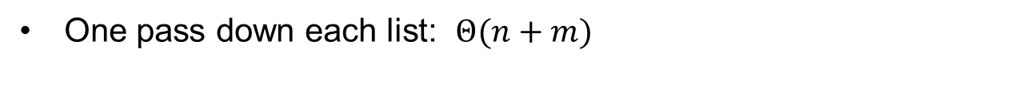
Addition of Two Polynomials
One pass down each list: $Θ(n+m)$
15+10x⁵⁰+3x¹⁰⁰
p
15
0
10
50
3
100
5+30x⁶⁰+4x¹⁰⁰
q
5
0
30
60
4
100
r
20
0
10
50
30
60
7
100

Slide 167
Sparse Matrices
m
1
1
18
3
33
4
4
99
6
6
27

Slide 168
Summary
List ADT
A sequence of elements (special case: string)
Array
Linked list
Accessors and mutators
Stepping through a linked list
Copy and assignment operator
Doubly linked list
Memory usage versus run times
Node-based storage with arrays
No longer need to call new for each new node
Application
Polynomial, sparse matrix

